Slide 1
Weather

Slide 2
Requirement 1

Slide 3
Explain how each of the following is formed:
Fog
- Fog = When water vapor condenses into tiny liquid water droplets that are suspended into the air.
Rain
- Rain = Droplets of water that fall from clouds
Dew
- Dew = Natural form of water, formed as water capor condenses
Sleet
- Sleet = Rain or melted snow that freezes into ice pellets before hitting the ground
Hail
-Hail = Forms on condensation nuclei such as dust, insects, or ice crystals, when super cooled water freezes on contact
Frost
- Frost = When an outside surface cools past the dew point

Slide 4
Requirement 2

Slide 5
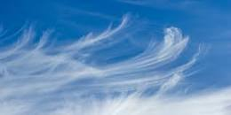
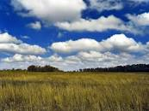
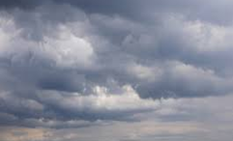
Identify either in the sky or from pictures the following types of clouds:
Cirrus
Cumulus
Stratus
Nimbus
Associated with fair weather
During cool and rainy weather
Usually bring precipitation, although if sufficiently low in altitude to become fog, drizzle or mist may result.
Found during rain storms

Slide 6
Requirement 3

Slide 7
What kind of weather is associated with each?
- Mercury or Spirit thermometer
Both have similar functions however unlike the mercury thermometer the contents of a spirit thermometer are less toxic and will evaporate quickly
- Mercury barometer
The simplest device to measure atmospheric pressure at a location. It consists of a glass tube closed at one end immersed in a container filled with mercury.

Slide 8
- Aneroid barometer
An instrument used for measuring pressure as a method that does not involve liquid
- Rain gauge
An instrument used by meteorologists and hydrologists to gather and measure the amount of liquid precipitation over an area in a predefined period of time

Slide 9
Requirement 4

Slide 10
Why is it possible to be rainy on one side of the mountain range and dry on the other?
Orographic lift – Occurs when an air mass is forced from a low elevation to a high elevation as it moves over rising terrain.
A) They receive more rainfall than low lying areas because the temperature on top of the mountains is lower than the temperature at sea level.
B) Most common winds are from the west or south-west, which arrive from the Atlantic Ocean and pick up moisture.

Slide 11
Requirement 5

Slide 12
Show with the help of a diagram how the earth's relationship to the sun produces the seasons
- The seasons are caused by the direction of the Earth's axis pointing relative to the Sun
- As the Earth orbits the Sun, the tilt of the Earth's axis stays lined up with the North Star

Slide 13
Requirement 6

Slide 14
What causes lightning and thunder?
- When the positive and negative charges grow large enough, a giant spark occurs between the two charges within the cloud.
- Thunder is caused by lightning

Slide 15
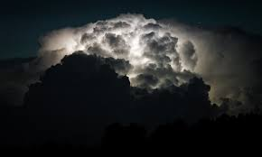
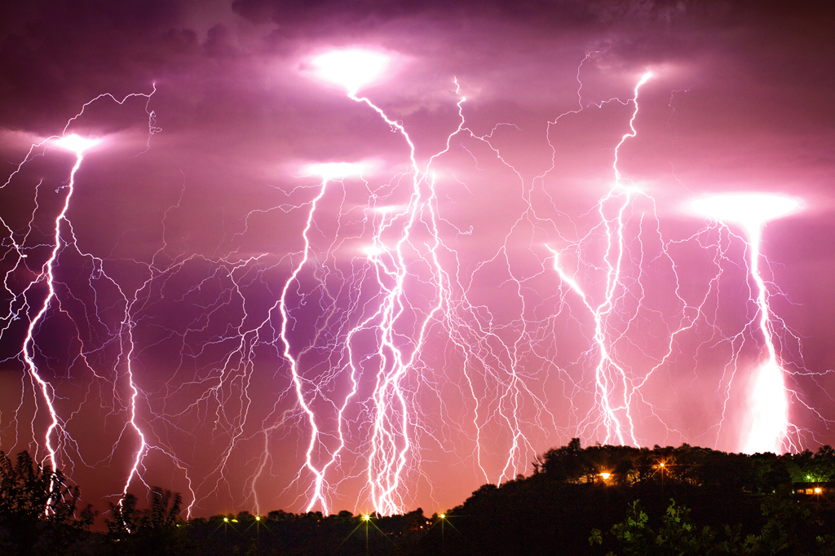
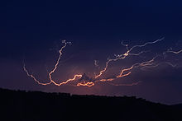
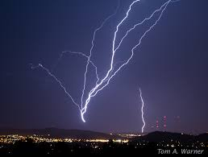
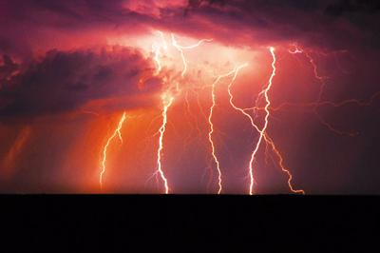
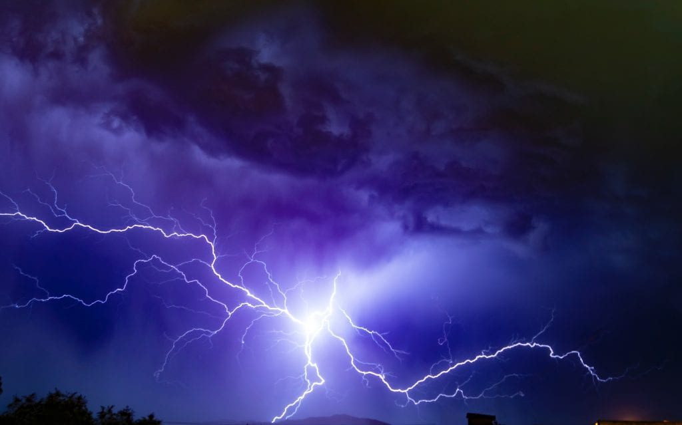
What are the different types of lightning?
Intracloud lightning
Cloud-to-ground lightning
Cloud-to-cloud lightning
Ground-to-cloud lighning
Heat lightning or summer lightning
Ball lightning
Notes:
Intracloud lightning - Most common type of lightning
Cloud to ground - Lowers a path of negative electricity towards the ground in a series of spurts
Cloud to cloud - Lightning occurs between two or more separate clouds
Ground to cloud - Inverted form of a cloud to ground
Heat lightning - A distant thunderstorm too far away to see the actual cloud to ground flash or hear accompanying thunder
Ball lightning – According to Lowke, this occurs in houses and aeroplanes when a stream of ions accumulates on the outside of a glass window and the resulting electric field on the other side excites air molecules to form a ball discharge

Slide 16
Requirement 7

Slide 17
Show with the help of a diagram what a convection is. What is its relation to winds?
A convection is the circular motion that happens when warmer air or liquid rises
Convection currents on a large-scale cause global wind
Convection currents on a small- scale cause local wind

Slide 18
Requirement 8

Slide 19
Explain how radar, satellite, and computers are used in weatherforecasting
Radar – Measures the velocity of objects such as drops of precipitation
Satellites – Instruments such as radiometers scan the Earth to form images
Computers – Helps meterorologists predict the weather

Slide 20
Requirement 9

Slide 21
Tell how the following can affect weather
Jet stream : Slim strips of strong winds have a huge influence on climate, as they can push air masses around and affect weather patterns
Volcano eruption : The gases and dust particles thrown into the atmosphere during volcanic eruptions have influence on climate

Slide 22
Requirement 10

Slide 23
Make a drawing showing the water cycle in weather

Slide 24
Requirement 11

Slide 25
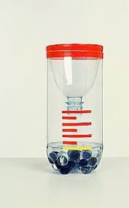
Make a simple wind vane or rain gauge
Rain Gauge
Equipment:
2 litre bottle
Some stones or pebbles
Tape
Marker
A ruler
Water
Instructions:
1. Cut the top of the 2 litre bottle
2. Place some stones in the bottom of the bottle. Turn the top upside down and tape it to the bottle
3. Use a ruler and marker pen to make a scale on the bottle.
4. Pour water into the bottle until it reaches the bottom strip on the scale.

Slide 26
Requirement 12

Slide 27
Keep a weather chart for one week and record readings at 12-hour intervals.
Include the following:
- Temperature
- Moisture (dew, fog, rain, frost or snow)
- Cloud formation
- Wind direction

