Slide 1
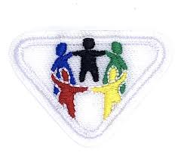
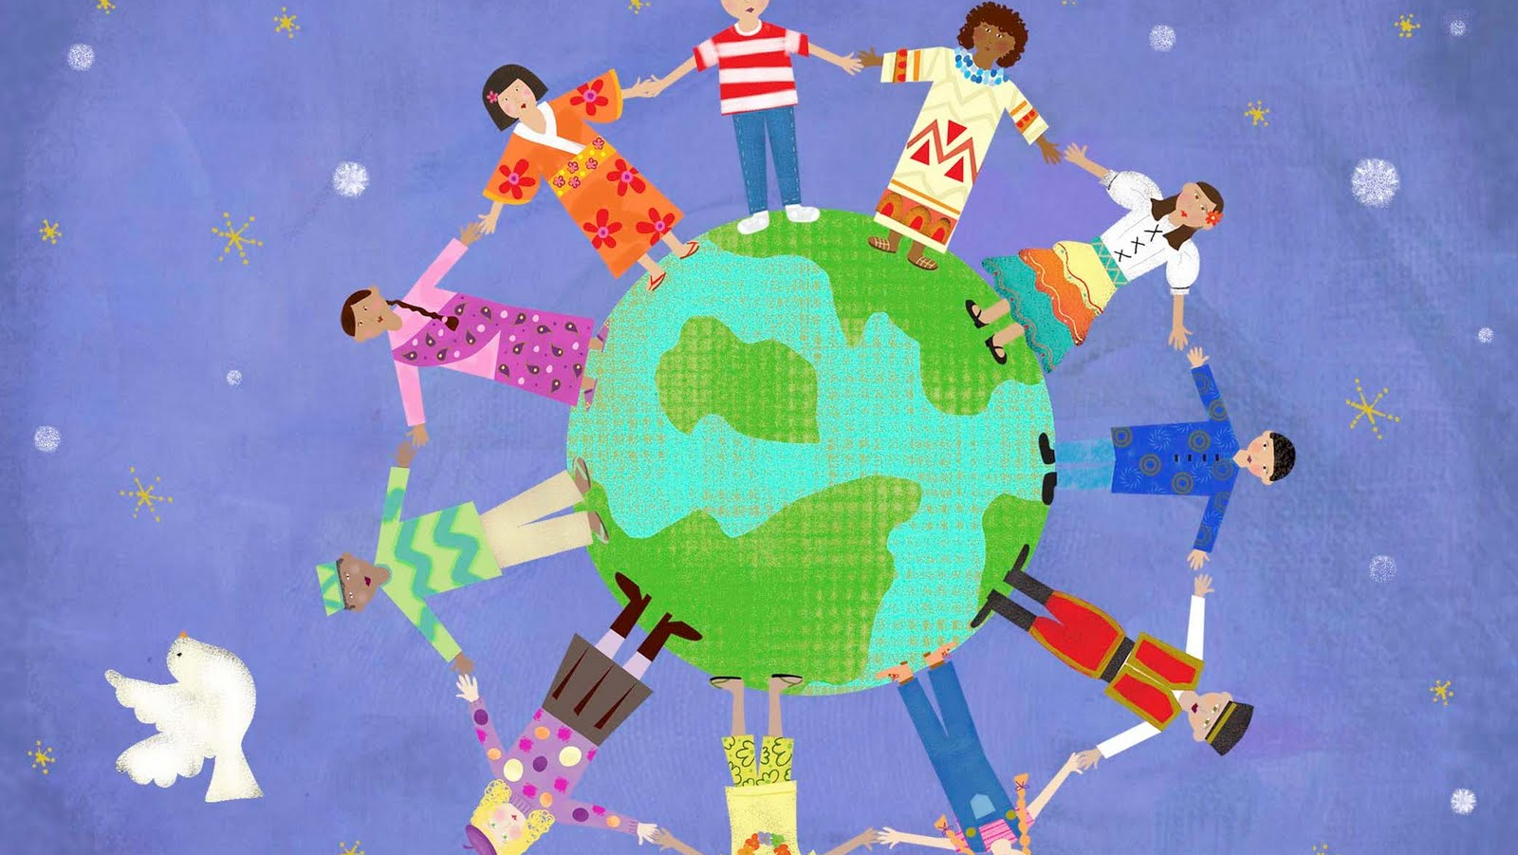
Acts of Kindness

Slide 2
Requirement 1

Slide 3
Read Romans 12:10; Proverbs 12: 25
Romans 12: 10 – Be kindly affectioned one to another with brotherly love; in honour preferring one another
Meaning: Be devoted to one another in love. Honour one another above yourselves
Proverbs 12: 25 – Heaviness in the heart of man maketh it stoop: but a good word maketh it glad
Meaning: Fear weighs down the heart, but a kind word cheers it up

Slide 4
Requirement 2

Slide 5
Examples of kindness and love
Parents love their children
Friends are kind to each other when playing together and working together
God loved us so much that he sent his son from heaven to Earth to live with us so that we may have everlasting life

Slide 6
Requirement 3
​

Slide 7
What does the Bible tell us about kindness and love?
New Testament – Parable of the Good Samaritan
Summary -
Christs uses this to teach us that we should always show kindness to others which helps us to follow the principle ‘love thy neighbor’.

Slide 8
Requirement 4

Slide 9
Read or listen to three stories of kindness
The story of Ruth, the story of kindness - https://blogs.timesofisrael.com/the-story-of-ruth-the-story-of-kindness/
Colour Your World with Kindness - https://youtu.be/rwelE8yyY0U
A limit of your Kindness - https://www.moralstories.org/a-limit-of-your-kindness/

Slide 10
Colour Your World with Kindness

Slide 11
Requirement 5

Slide 12
Charades: Guessing Game

Slide 13
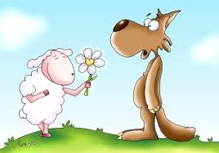

Slide 14
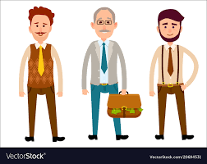
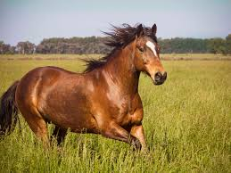
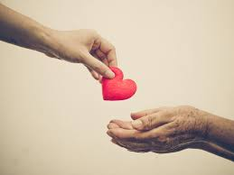

Slide 15
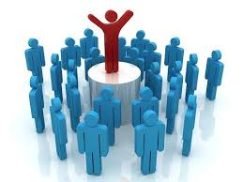
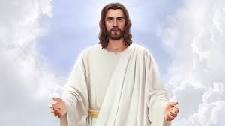

Slide 16
Requirement 6

Slide 17
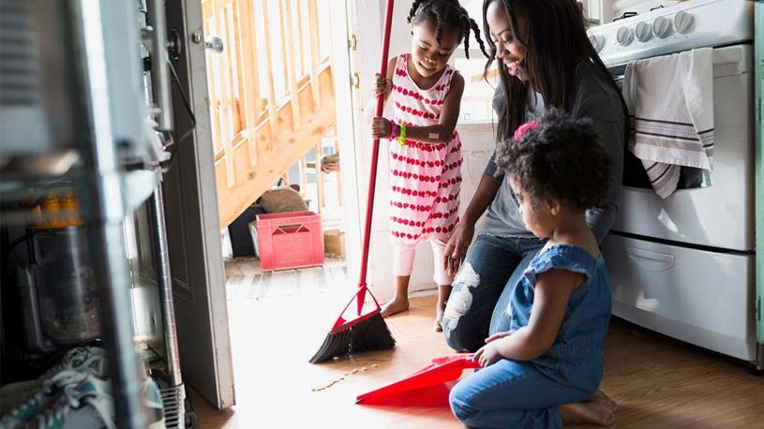
Help PARENTS WITH CHORES

Slide 18
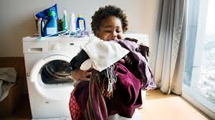
Help HANG OUT THE WASHING

Slide 19
Make a Card for a Friend

Slide 20
Say please and thank you

Slide 21
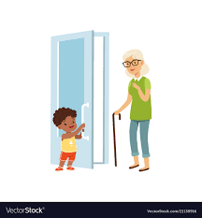
OPEN THE DOOR FOR AN ELDERLY/ DISABLED

Slide 22
Take part in an act of Kindness
Help parents with chores
Help hang the washing
Make a card for a friend
Say please and thank you

