Slide 1
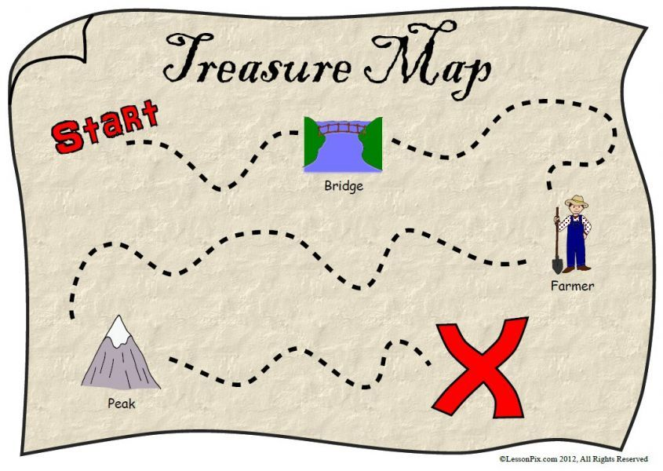
Scavenger Hunt
By Sindi Mkwanazi

Slide 2
Job 12 vs 7-9
“But ask the animals, and they will teach you, or ask the birds of the air, and they will tell you. Speak to the earth, and it will teach you, or let the fish of the sea tell you. Every one of these knows that the hand of the Lord has done this.

Slide 3
Bible Verse Poster.
What we need
Paper
Colouring pencils
Pen or pencil

Slide 4
Scavenger Hunt Rules & Instructions
ALL ITEMS MUST BE PUT INTO A BAG OR PLASTIC WALLET
Mummy’s and Daddy’s can help you

Slide 5
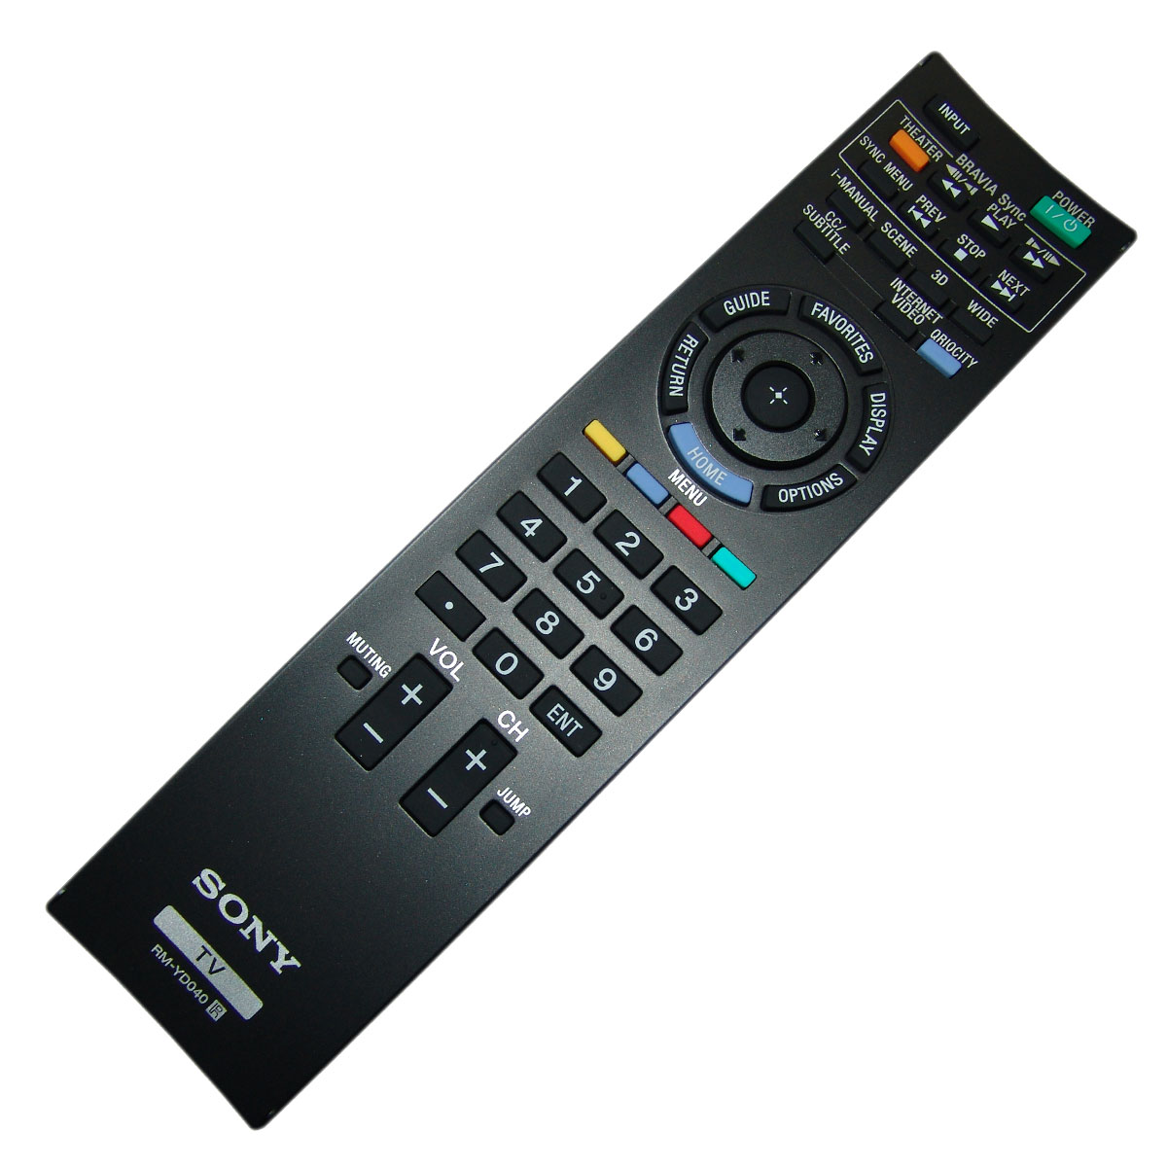
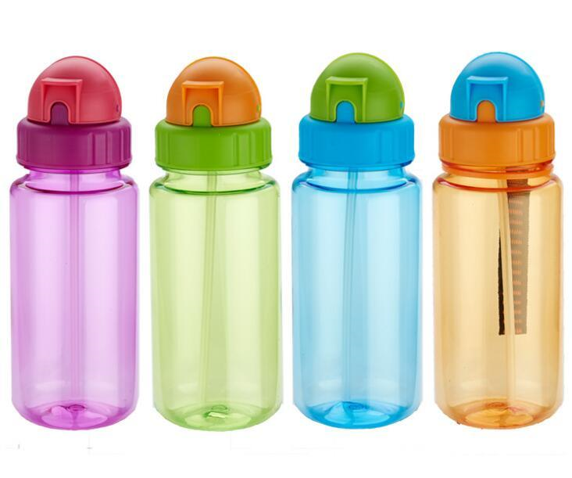
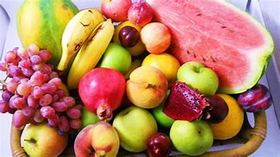
Round 1: sight
Find the items I put on the screen.
You have 3 minutes to get them all
2. EMPTY WATERBOTTLE
3. ANY FRUIT
1. TV REMOTE

Slide 6
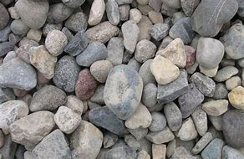
Round 2: Nature
Find the items I put on the screen.
You have 3 minutes seconds to go outside and collect them all
5 stones
3 Leaves
1 Flower

Slide 7
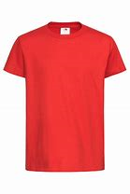
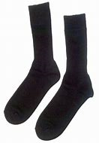
Round 3: Colours
Find the items I put on the screen.
You have 3 minutes seconds to go outside and collect them all
4 black socks
1 Red T-shirts

Slide 8
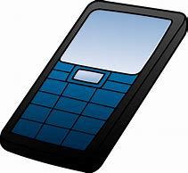
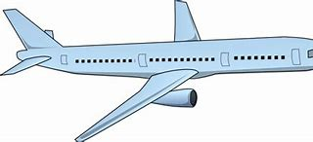
Round 4: Drawing
You have 5 minutes to draw and colour these 3 things I will put on the screen
It does not need to be the same as the picture.
Butterfly
Trees
Phone
Aeroplane

Slide 9
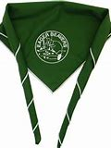
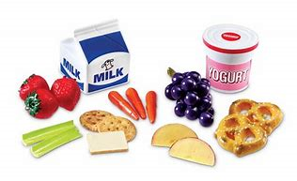
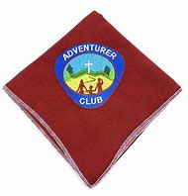
Round 5: Church
You have 8 minutes to get ready for church . Then you must have these items with you . You must wear your scarf
Bible
Snack (crisps, fruit, yoghurt etc.)
Eager beaver/adventurer scarf

Slide 10
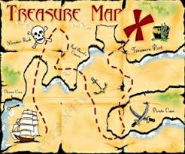
THE SCAVENGER HUNT IS OVER

