Slide 1
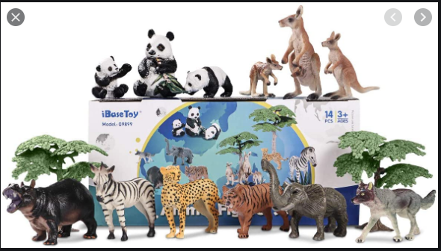
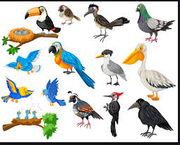
ZOO ANIMALS AWARD REQUIREMENTS
Take a trip to the zoo, if possible or watch a video or movie about a zoo. https://www.youtube.com/watch?v=I0gzpFoSqXE
What animals did you see?
What kind of food did most of them eat?
Did you see any birds. If so, what were they? Name them.
Draw or colour 2 things you saw at the zoo.
Who made everything you saw at the zoo? Can you find the answer in the Bible? If so, where can it the found?

Slide 2
AT THE ZOO
1. Take a trip to the zoo, if possible or watch a video or movie about a zoo. https://www.youtube.com/watch?v=I0gzpFoSqXE
https://www.youtube.com/watch?v=OwRmivbNgQk
https://www.youtube.com/watch?v=4jsTsqMJ51M

Slide 3
At The ZOO
2. What animals did you see?

Slide 4
AT THE ZOO
3. What kind of food did most of them eat?

Slide 5
At The ZOO
4. Did you see any birds. If so, what were they? Name them.

Slide 6
AT THE ZOO
5. Draw or colour 2 things you saw at the zoo.

Slide 7
AT THE ZOO
6. Who made everything you saw at the zoo? Can you find the answer in the Bible? If so, where can it the found?
Genesis 1:25 God made the wild animals according to their kinds, the livestock according to their kinds, and all the creatures that move along the ground according to their kinds. And God saw that it was good. Psalm 50:10 For all the animals of the forest are mine, and I own the cattle on a thousand hills. Psalm 104:24 How many are Your works, O LORD! In wisdom You have made them all; the earth is full of Your creatures. God made all the wild and domestic animals that are in the Zoo.

Slide 8
Genesis 5:32-10:10-1

Slide 9
Genesis 6:17-18
¹⁷ I am going to bring floodwaters on the earth to destroy all life under the heavens, every creature that has the breath of life in it. Everything on earth will perish. ¹⁸ But I will establish my covenant with you, and you will enter the ark—you and your sons and your wife and your sons’ wives with you.

Slide 10
God saw that all the people on the earth were acting badly, so he decided to send a flood that would wipe out evil.

Slide 11
However, there was one good man on earth. His name was Noah and God trusted him.

Slide 12
God decided that he would save Noah by telling him that the flood was coming. He would instruct Noah to build a really big boat, called an ark. After Noah had built the ark, God told him to put pairs of every animal on the earth in it, a male and female of each type. & 7pairs of each clean animal and 7 pairs of each bird.

Slide 13
When Noah, his family and the animals were all safely on the ark, the rain began to fall. It kept falling for forty days and nights. The waters flooded the earth. Every living thing on the face of the earth was wiped out except for Noah, his family and the animals who were safe in the ark.

Slide 14
When the sun came out, the waters started to dry up and the ark came to rest on a mountain called Mount Ararat. After 150 days of floating, the ark rested on the mountain. Noah sent out a raven to find dry land, but it kept going back and forth. A few days later, he sent out a dove. The dove returned straight away because it could not find a resting place. Noah waited a few more days and sent the dove again. It came back with an olive leaf in its beak. When the dove was sent out again, it did not return. Noah knew that the ground was dry and that it was safe for him and the animals to come out of the ark.

Slide 15
‘ The waters must have dried up completely!’ exclaimed Noah. So, all the animals and Noah’s family left the ark. God promised that he would never again send another flood that covered the earth and made a rainbow in the sky to remind everyone of his promise. So when you see a rainbow, remember God’s promise that he will never destroy the earth with the floods again.

