Slide 1
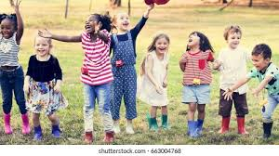
I AM SPECIAL

Slide 2
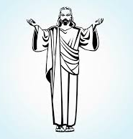
I am special because
Jesus loves and cares for me
Read Luke 18:16 NLT
Then Jesus called for the disciples and said to them “Let the children come to me. Don’t stop them! For the Kingdom of God belongs to those who are like these children.

Slide 3
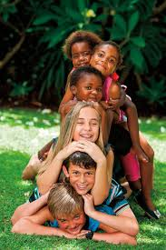
Physical Characteristics
Hair colour
Height
Weight
Hair colour
Skin colour
Gender
Eye colour

Slide 4
Internal characteristics
Galatians 5:22-23 Jesus wants us to have these in our hearts
Love
Joy
Peace
Patience
Kindness
Goodness
Faithfulness
Gentleness
Self control

Slide 5
So what characteristics make a good friend?

Slide 6
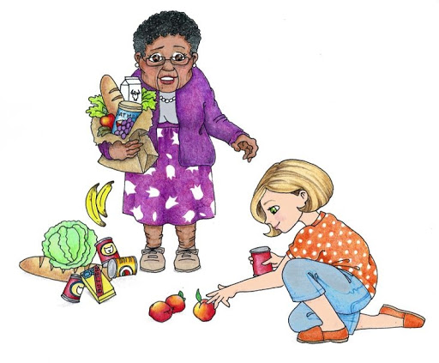
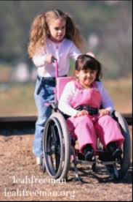
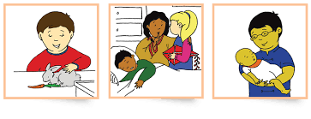

Slide 7
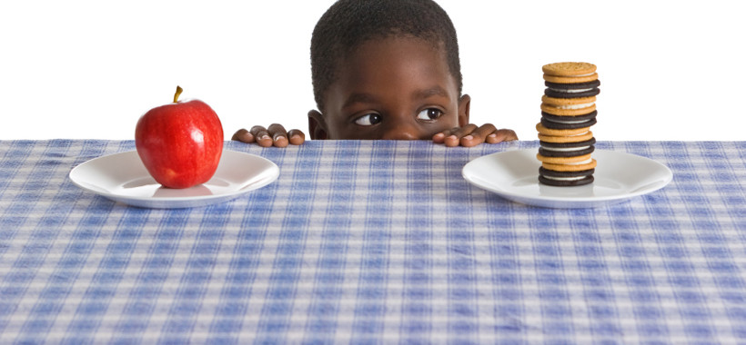
I can make wise choices
Choice is an act of choosing between two or more things.
What if you had £50, how would you spend it?
What if you had only one week to live, what would you do with it?
What if, of all the people in the world, you could choose only three friends, which three would you choose?
Bible verses: proverbs 3:5-6, Jeremiah 29:11

Slide 8
Required materials for the session
Butcher craft paper roll for body tracing
Black marker
Pencil and colouring pencils
Sticky note pads
Cut out pictures showing kindness, love, happiness, peace, goodness, patience, pictures showing feelings
Glue, glitter
Bible
Clear tape
Child’s favourite decorations.

