Slide 1
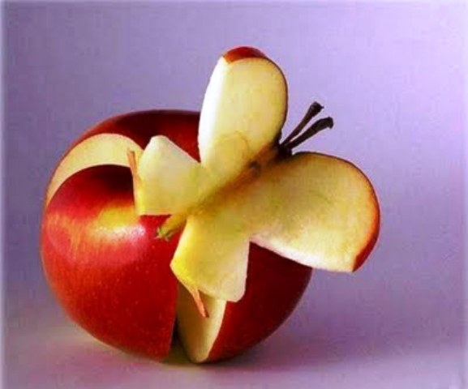
Teaching Creativity Skills

Slide 2
Introduction To Teaching Skills
Purpose
Objectives
To Explore the different learning and teaching styles and teachable moments conducive for Pathfinders and Adventurers physical, mental, social and spiritual development
To discover the importance and value of creative approaches to teaching and to learn ways of developing one’s own creative style of teaching

Slide 3
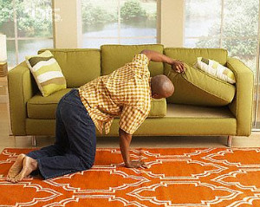
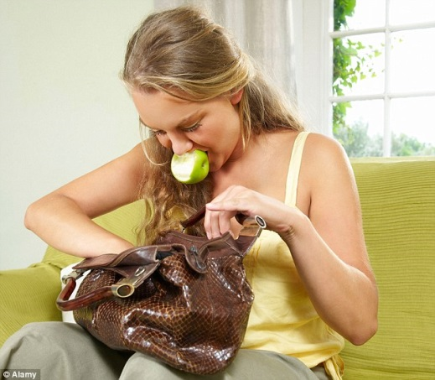
What is Creativity? Find the answers - Activity 1
First team back gets a reward!
In 2’s or 3’s
Find the 5 different colour cards hidden in the room.

Slide 4
What is Creativity? 1. Creativity is the act of turning new and imaginative ideas into reality.
2. Creativity is characterised by the ability to perceive the world in new ways, to find hidden patterns, to make connections between seemingly unrelated phenomena, and to generate solutions.
3. Creativity involves two processes: thinking, then producing. If you have ideas, but don’t act on them, you are imaginative but not creative.
5. Mental Characteristic that allows a person to think outside of the box, which results in innovative or different approaches to a particular task.
4. In order to be creative, you need to be able to view things in new ways or from a different perspective

Slide 6
Understanding Creativity
Purpose
Value
The reason for which something is done/exists
An intended or desired
Result/Goal/Aim/End
The
- importance
- worth
- usefulness
of something

Slide 7
Activity 2
Under the chairs you will find an envelope
Discuss the statement with small group 3’s or 4’s
Place the statement under the Purpose or Value heading on the wall

Slide 8
It makes learning more enjoyable , lasting and meaningful • It approaches opportunity of self‐expression and development of creativity • It instills pride in accomplishment and build self confidence • It contributes to the development of proper self concepts
􀁹 It provides for participation in groups situation and reaction to established group approval and behaviour
􀁹 Its deepens a Pathfinder’s need for individual expression.
􀁹 Its relieves period of physical restlessness with meaningful activity, coordination mind and muscle.
􀁹 it promotes respect for both adults and peer relationship
􀁹 It afford opportunity to practice principles of Christian living.
• Helps the Pathfinder respect property of
others
• Teaches cooperation, sharing and taking turns.
• Emphasise a Bible concept or illustrate a truth
• Provide opportunity for the Pathfinder to
express his/her relationship with God and a
response to Bible teaching

Slide 9
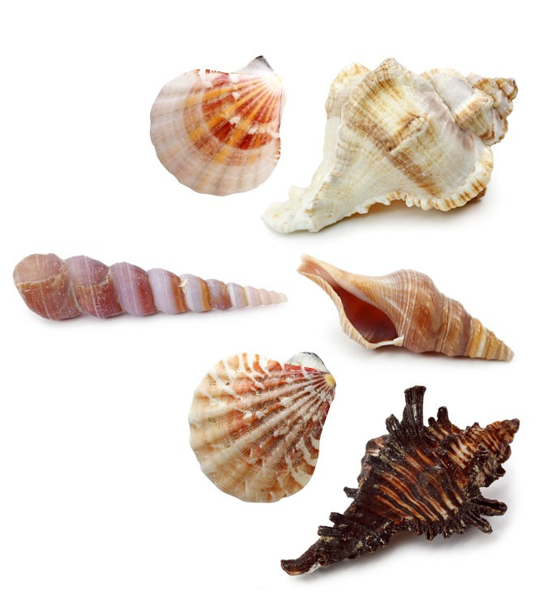
1. Conchology is the
Study of trees
Study of shells
Study of measurements
Study of People
B. Study of shells

Slide 10
2. Geology is the
Study of trees
Study of caves
Study of shells
Study of books
Study of the earth
E. Study of the earth

Slide 11
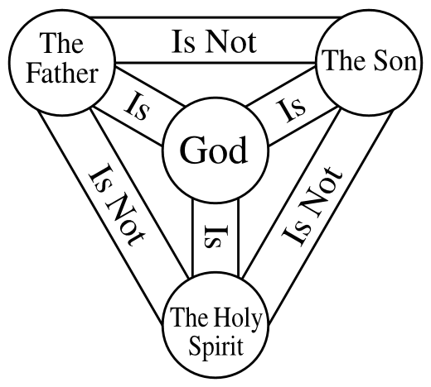
3. Theology is the
Study of words
Study of the Bible
Study of God
Study of computers
C. Study of God

Slide 12
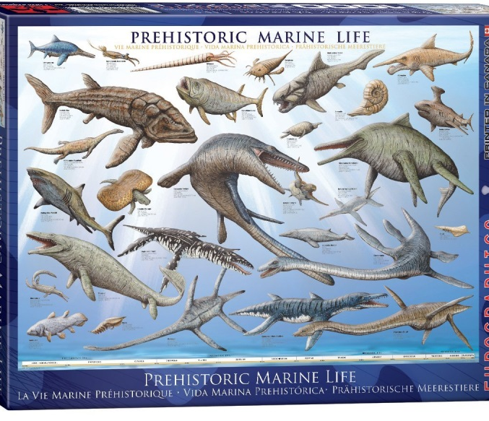
4. Paleontology is the
Study of prehistoric life
Study of cells
Study of rocks & minerals
Study of shrubs
Study of marine invertebrates
A. Study of prehistoric life

Slide 13
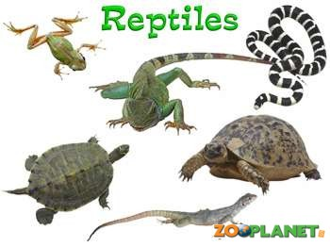
5. Herpetology is the
Study of herbs
Study of small mammals
Study of lichens
Study of reptiles
Study of God
D. Study of reptiles

Slide 14
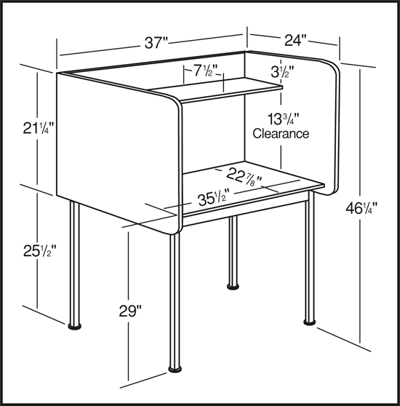
6. Metrology is the
Study of meteors
Study of measurements
Study of heavenly bodies
Study of cells
Study of music scores
B. Study of measurements

Slide 15
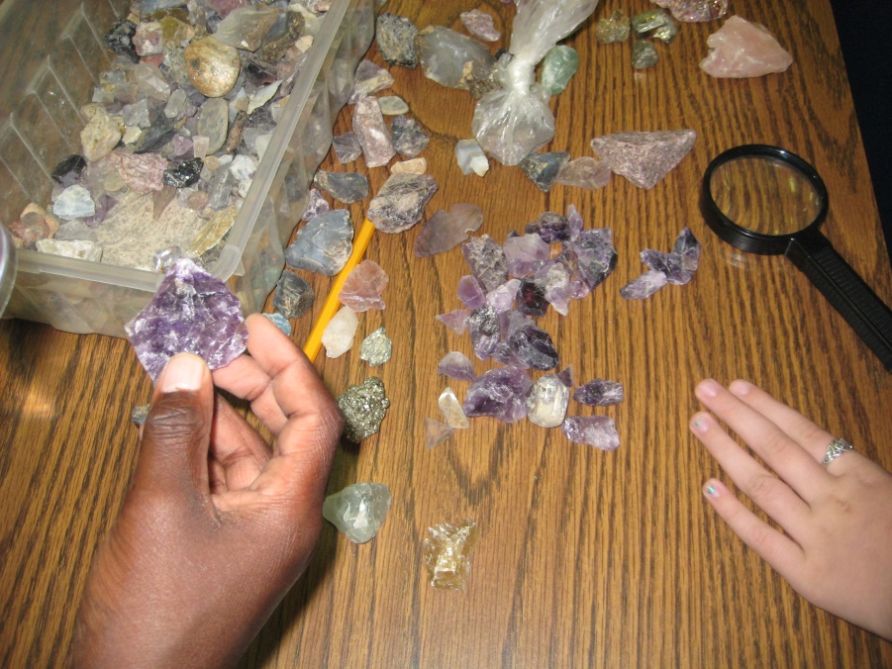
7. Lithology is the
A. Study of emotions
B. Study of insects
C. Study of fruit growing
D. Study of rocks
E. Study of prehistoric life
D. Study of rocks

Slide 16
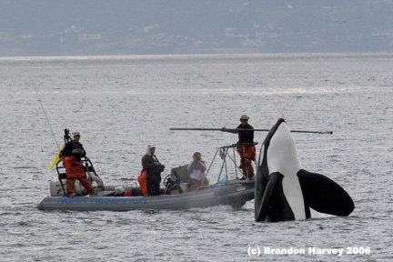
8. Cetology is the
Study of whales
Study of insects
Study of dogs
Study of cacti
Study of seeds
Study of whales

Slide 17
9. Cytology is the
Study of cats
Study of cacti
Study of the internet
Study of human life
Study of cells
E. Study of cells

Slide 18
10. Dendrology is the
Study of trees
Study of orchids
Study of stars
Study of environmental conservation
Study of trees

Slide 19
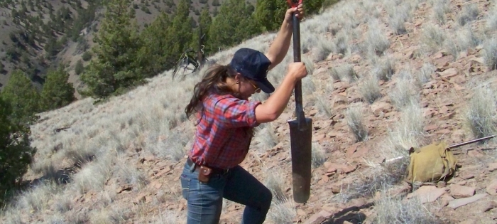
11. Agrology is the
Study of microscopic plant life
Study of basket making
Study of lichens
Study of mushrooms
Study of soil for crops
E. Study of soil for crops

Slide 20
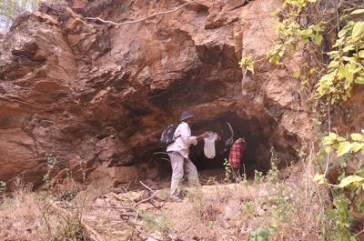
12. Speleology is the
Study of caves
Study of soil for crops
Study of modern communications
Study of the Northern Lights
Study of stars
Study of caves

Slide 21
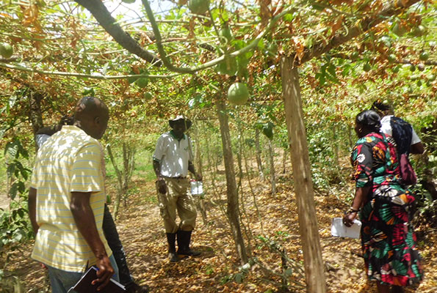
13. Pomology is the
Study of God's creation
Study of fruit growing
Study of Tree rings
Study of human origins
B. Study of fruit growing

Slide 22
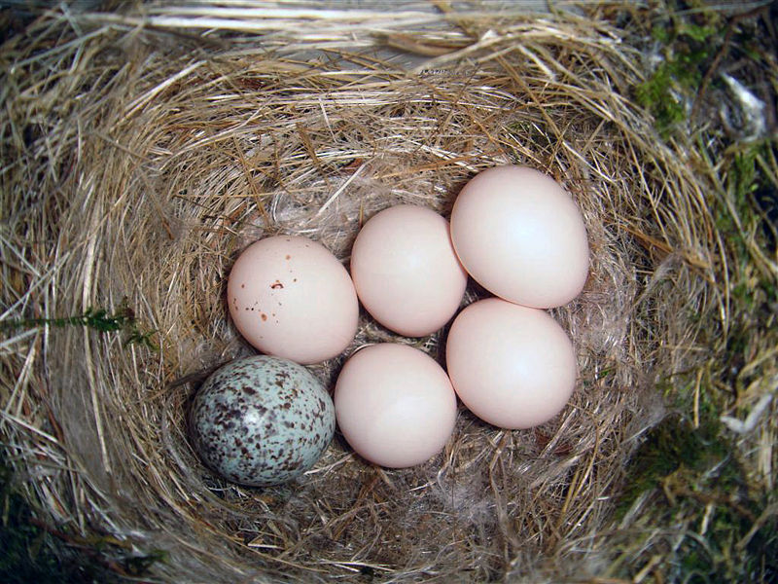
14. Oology is the
Study of birds eggs
Study of zoo life
Study of small mammal pets
Study of fish raising
A. Study of birds eggs

Slide 23
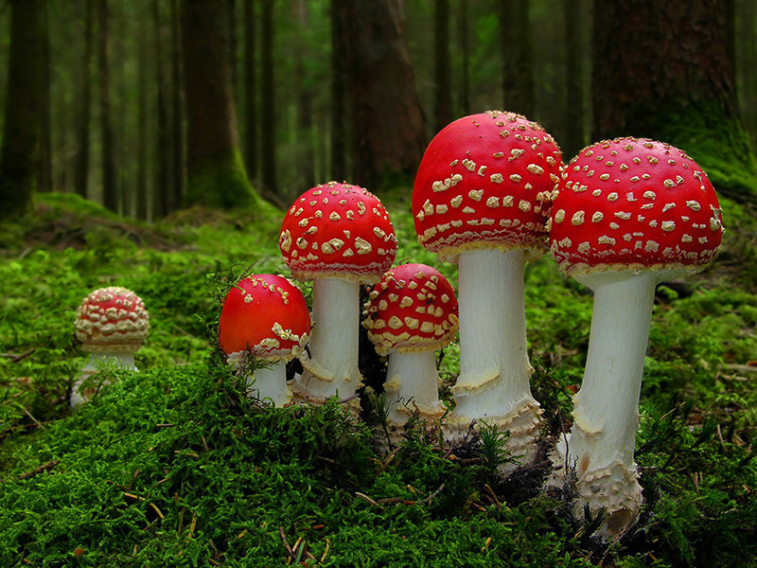
15. Mycology is the
Study of words
Study of microscopic life
Study of tropical fish
Study of fungi
Study of cells
D. Study of fungi

Slide 24
Steps to being creative
Step one: Become a knowledgeable teacher
Step two: Connect with other teachers/trainers
Step three: Become a collector of teaching/training ideas
Step four: Share your learning
Step five: Remove the blocks to creative thinking
Step six: Practise your creativity

Slide 25
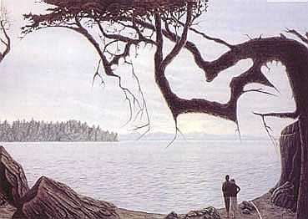
What can you see?

Slide 26
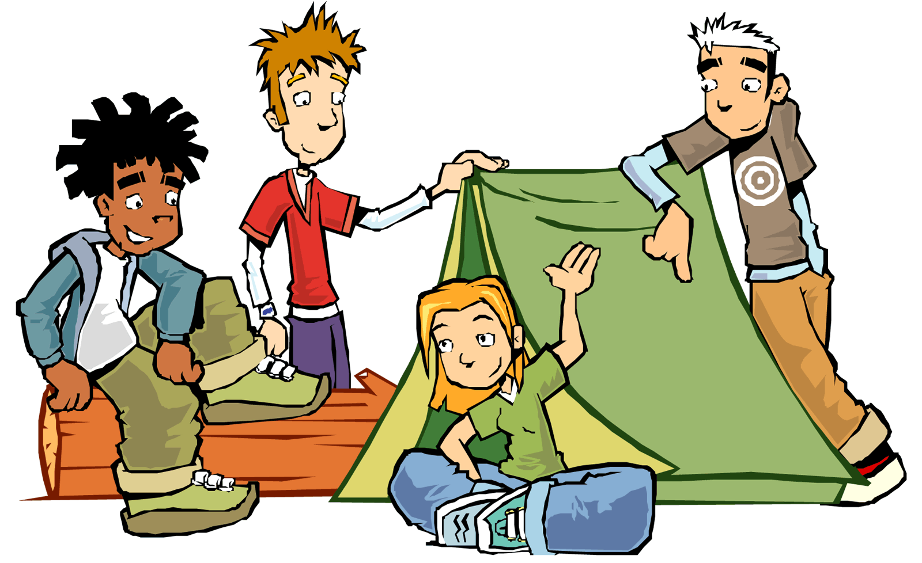
We Gain Knowledge about God, the world and ourselves
Visiting places
Being involved with people
Talks
Taking part in events and activities
Audio Visuals
Reading
Discussions

Slide 27
Creative Tools for Effective Teaching:
Aim of Lesson
Learning atmosphere
Teaching aids
Be creative
Use a variety of creative resources
Story telling
Finding things
Treasure hunt
Singing
Questions
Puzzles
Mime
Drama
Role play
Debates
Discussions
Quiz
Demonstrations

Slide 28
How many additional birds can you find?
Answer: Ten birds

Slide 29
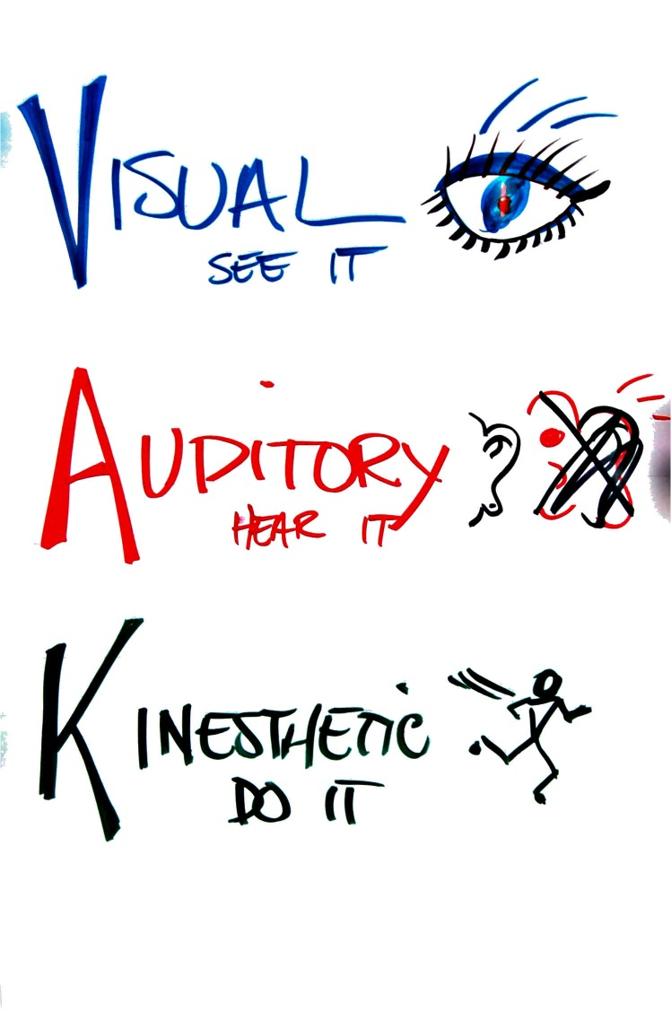
Activity
Different
Learning
Styles

Slide 30
Each Pathfinder/Adventurer Learns Differently
Discover how your Pathfinder/Adventurer learns best and you will discover the best way to keep their attention

Slide 31
Teaching the Pathfinder/Adventurer Curriculum Creatively
You must know/study the Curriculum
Assess the number and needs of your class
Work out your teaching plan
Available resources
Plan your work and Work your plan

Slide 32
Teaching Task
Divide into groups of 4-6
As a group, choose one requirement from either the Pathfinder or Adventurer coursework, Award or Honour and decide how you would best teach it
Create a teaching plan
Lesson Objective
Success Criteria
Basic 3 part lesson (Intro/Main/Plenary)
Assessment?

Slide 33
Thank You
Any Questions?

Slide 35
1. When I operate new equipment I generally: a) read the instructions first b) listen to an explanation from someone who has used it before c) go ahead and have a go, I can figure it out as I use it 2. When I need directions for travelling I usually: a) look at a map b) ask for spoken directions c) follow my nose and maybe use a compass 3. When I cook a new dish, I like to: a) follow a written recipe b) call a friend for an explanation c) follow my instincts, testing as I cook

Slide 36
4. If I am teaching someone something new, I tend to:
a) write instructions down for them
b) give them a verbal explanation
c) demonstrate first and then let them have a go
5. I tend to say:
a) watch how I do it
b) listen to me explain
c) you have a go
6. During my free time I most enjoy:
a) going to museums and galleries
b) listening to music and talking to my friends
c) playing sport or doing DIY

Slide 37
7. When I go shopping for clothes, I tend to: a) imagine what they would look like on b) discuss them with the shop staff c) try them on and test them out 8. When I am choosing a holiday I usually: a) read lots of brochures b) listen to recommendations from friends c) imagine what it would be like to be there 9. If I was buying a new car, I would: a) read reviews in newspapers and magazines b) discuss what I need with my friends c) test-drive lots of different types

Slide 38
10. When I am learning a new skill, I am most comfortable:
a) watching what the teacher is doing
b) talking through with the teacher exactly what I’m supposed to do
c) giving it a try myself and work it out as I go
11. If I am choosing food off a menu, I tend to:
a) imagine what the food will look like
b) talk through the options in my head or with my partner
c) imagine what the food will taste like
12. When I listen to a band, I can’t help:
a) watching the band members and other people in the audience
b) listening to the lyrics and the beats
c) moving in time with the music

Slide 39
13. When I concentrate, I most often:
a) focus on the words or the pictures in front of me
b) discuss the problem and the possible solutions in my head
c) move around a lot, fiddle with pens and pencils and touch things
14. I choose household furnishings because I like:
a) their colours and how they look
b) the descriptions the sales-people give me
c) their textures and what it feels like to touch them
15. My first memory is of:
a) looking at something
b) being spoken to
c) doing something

Slide 40
16. When I am anxious, I:
a) visualise the worst-case scenarios
b) talk over in my head what worries me most
c) can’t sit still, fiddle and move around constantly
17. I feel especially connected to other people because of:
a) how they look
b) what they say to me
c) how they make me feel
18. When I have to revise for an exam, I generally:
a) write lots of revision notes and diagrams
b) talk over my notes, alone or with other people
c) imagine making the movement or creating the formula

Slide 41
19. If I am explaining to someone I tend to:
a) show them what I mean
b) explain to them in different ways until they understand
c) encourage them to try and talk them through my idea as they do it
20. I really love:
a) watching films, photography, looking at art or people watching
b) listening to music, the radio or talking to friends
c) taking part in sporting activities, eating fine foods and wines or dancing
21. Most of my free time is spent:
a) watching television
b) talking to friends
c) doing physical activity or making things

Slide 42
22. When I first contact a new person, I usually:
a) arrange a face to face meeting
b) talk to them on the telephone
c) try to get together whilst doing something else, such as an activity or a meal
23. I first notice how people:
a) look and dress
b) sound and speak
c) stand and move
24. If I am angry, I tend to:
a) keep replaying in my mind what it is that has upset me
b) raise my voice and tell people how I feel
c) stamp about, slam doors and physically demonstrate my anger

Slide 43
25. I find it easiest to remember:
a) faces
b) names
c) things I have done
26. I think that you can tell if someone is lying if:
a) they avoid looking at you
b) their voices changes
c) they give me funny vibes
27. When I meet an old friend:
a) I say “it’s great to see you!”
b) I say “it’s great to hear from you!”
c) I give them a hug or a handshake

Slide 44
28. I remember things best by:
a) writing notes or keeping printed details
b) saying them aloud or repeating words and key points in my head
c) doing and practising the activity or imagining it being done
29. If I have to complain about faulty goods, I am most comfortable:
a) writing a letter
b) complaining over the phone
c) taking the item back to the store or posting it to head office
30. I tend to say:
a) I see what you mean
b)I hear what you are saying
c) I know how you feel

Slide 45
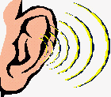
Now add up how many A’s, B’s and C’s you selected. A’s = B’s = C’s =
If you chose mostly A’s you have a VISUAL learning style.
If you chose mostly B’s you have an AUDITORY learning style.
If you chose mostly C’s you have a KINAESTHETIC learning style.

Slide 46
Developing Creative Resources
Resources can be found:
Curriculum requirement books
People
Places
Video’s, DVD’s and the Internet

Slide 48
Activity Time
Newspaper Search
and Find Game

Slide 49
How To Develop Creative Worship
At the heat of every Christian is a relationship – with Jesus

Slide 50
Enjoyable Worship
Attitude
Creativity

Slide 51
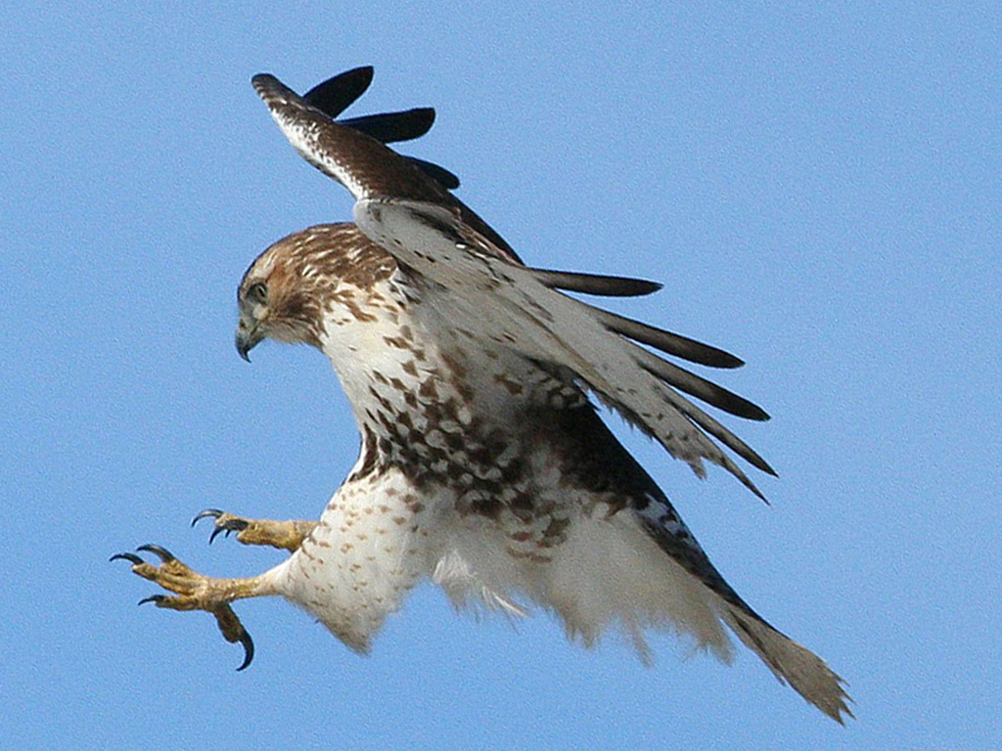

Slide 53
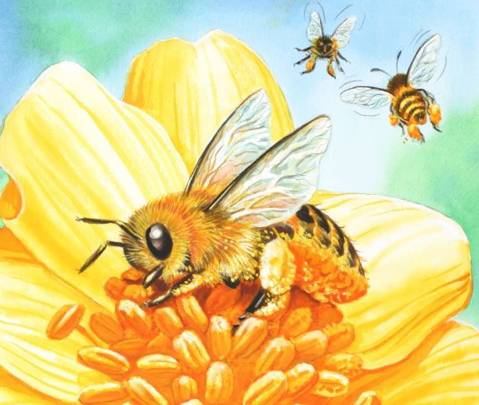

Slide 54
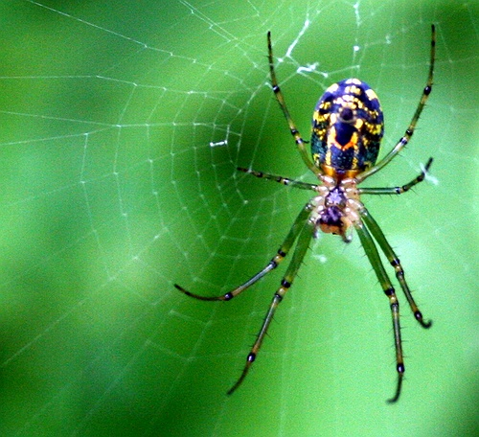

Slide 55
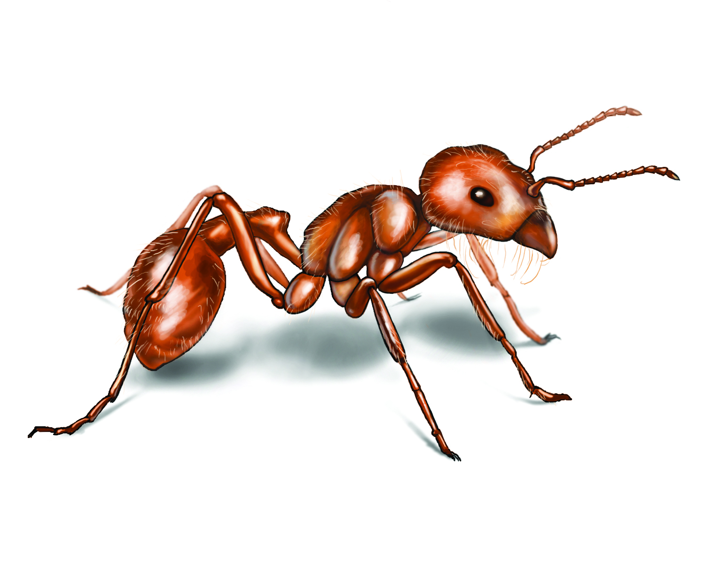

Slide 56
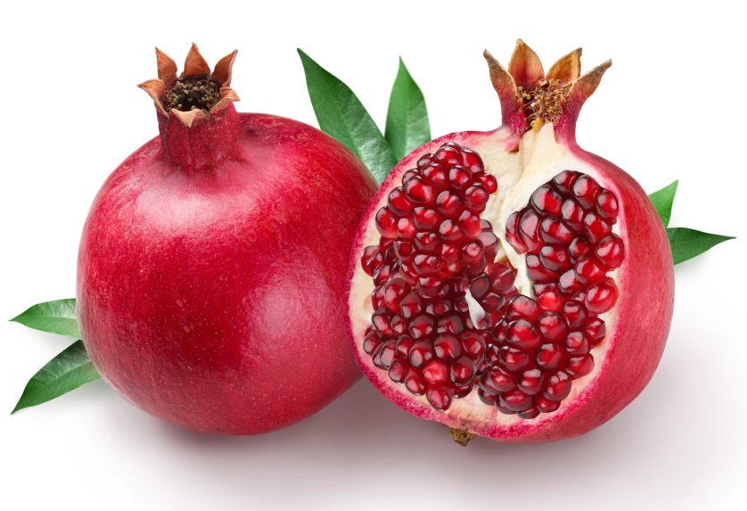

Slide 58
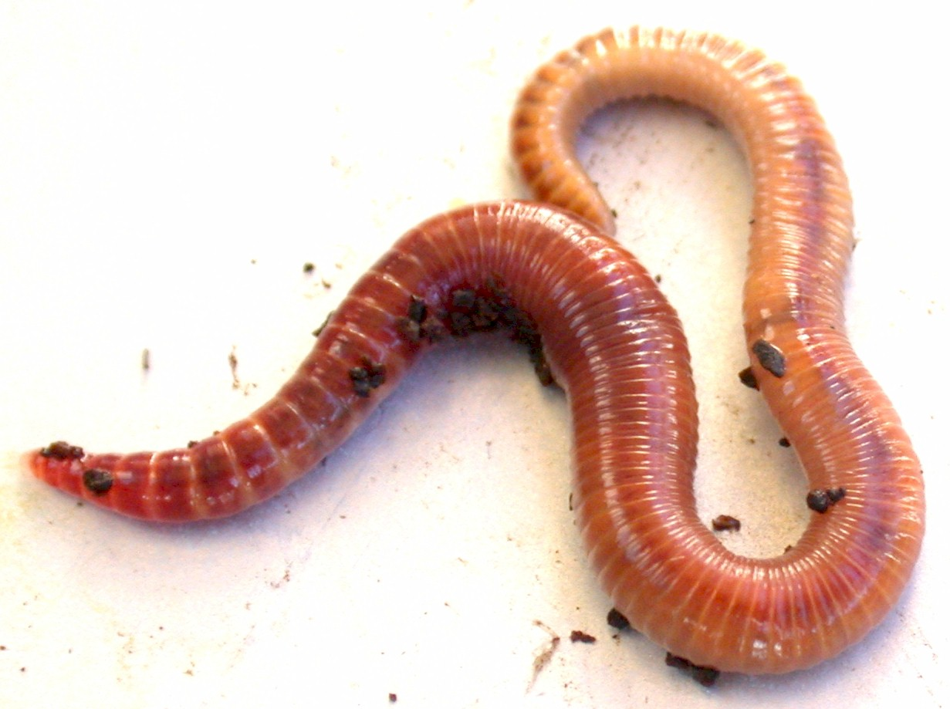

Slide 60
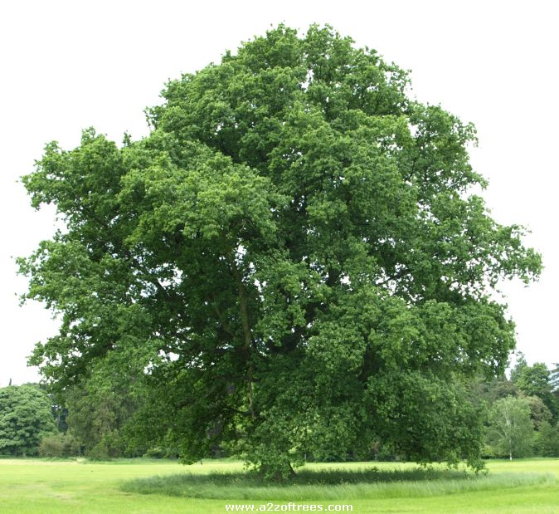

Slide 61
How We Learn
Absorbing Information
Our Own Experiences

Slide 62
2 Main Differences How We Learn
How we perceive information
How we process information

Slide 63
Here are some principles related to how we learn:
Motivation
Practice
Past Experience
Level of maturity
Reinforcement
Activity
Transfer of learning

Slide 64
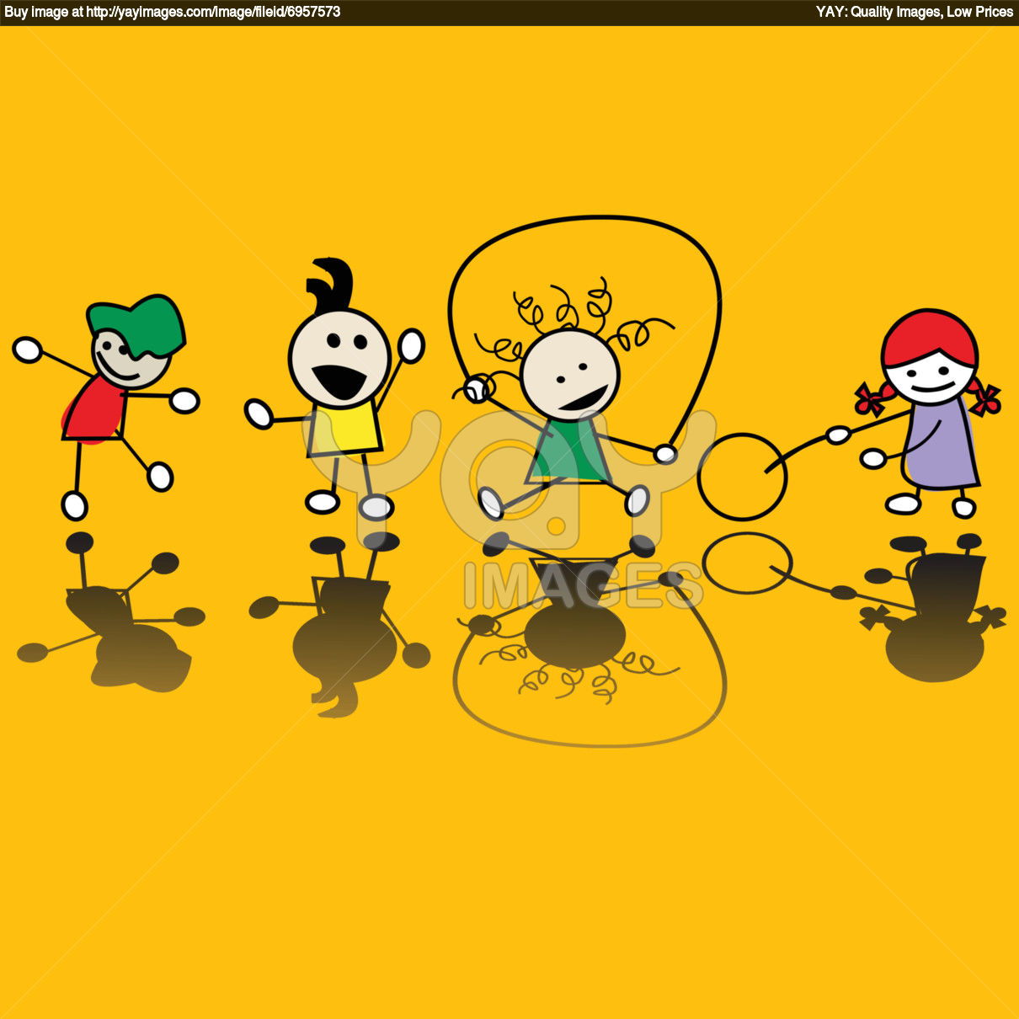
Game – 1, 2, 3 Sign, Sign

