Slide 1
CATS HONOUR FELIDAE
Species Overview

Slide 2
Cats Honour - Requirements
1. What is the scientific name of the cat family?
2. How is the structure of the paw similar in all cats?
3. How are the eyes of all cats alike?
4. What is the main food of the cat family? How are the cat's teeth fitted for this?
5. Of what use are the cat's whiskers?
6. How are the cat's ears protected?
7. Identify from pictures or personal observation four kinds of domesticated cats. Describe each one's temperament.
8. Of what benefit to man are domesticated cats?
9. Identify from pictures or personal observation seven kinds of undomesticated cats. Tell in what part of the world they are found.
10. What animal is known as the king of beasts? Why does it have that title? What is it's temperament really like?
11. Tell the story of Androcles and the Lion.
12. Relate four stories from the Bible in which a member of the cat family is mentioned.

Slide 3
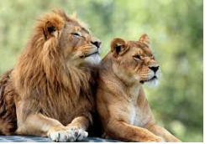
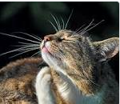
What is the scientific name of the cat family?
Felidae is a family of mammals in the order Carnivora, colloquially referred to as cats. A member of this family is also called a felid. The term "cat" refers both to felids in general and specifically to the domestic cat
How is the structure of the paw similar in all cats? ... Cats have five toes on each of the front paws, and four toes on each of the back paws. Their claws are retractable, and they have soft pads on the bottom of each paw.
Family: Felidae;
Kingdom: Animal
Order: Carnivora
Class: Mammals
Lifespan: Cat: 2 – 16 years, Lion: 10 – 14 years,
Gestation period: Cat: 58 – 67 days, Lion: 110 days

Slide 4
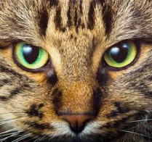
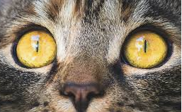
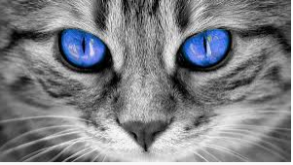
How are the eyes of all cats alike?
Cat's pupils are wide open in the dark, and contract to slits when exposed to the light.
The back of the eye is coated with a reflecting surface.
In low light levels the cats pupil must be able to open as wide as possible, but also be able to contract to very small size to protect the sensitive retina in bright sunlight.
In human eyes, this size variation of the pupil is controlled by a circular ciliary muscle, but this limits the amount of size variation.
In cats however, the same process is controlled by two, shutter-like ciliary muscles, which gives the cat it’s characteristic slit-like pupil in bright light conditions.
All cats pupils are therefore elliptical. However, the pupils of some (notably the ‘Big Cats’) appear more circular when dilated.

Slide 5
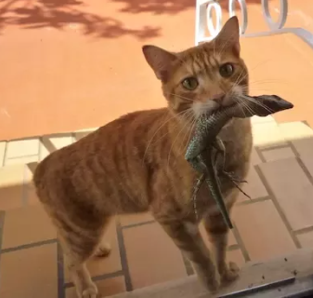
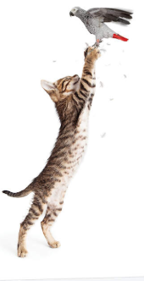
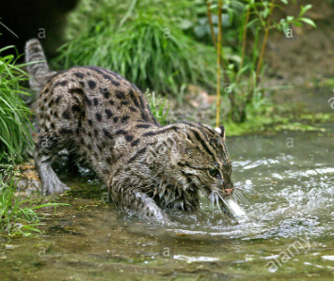
3. What is the main food of the cat family? 4. How are the cat's teeth fitted for this?
The main food of the cat family is meat. They have four front canine teeth for biting and tearing, and knife-edged teeth on sides for cutting skin and muscle.

Slide 6
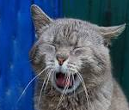
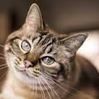
5. Of what use are the cat's whiskers?
Cat's whiskers are connected to sensitive nerves, and act like extra fingers for feeling things.
The whiskers on the cat are specialized sensory hairs grouped in three specific locations on the cats head.
The supercilary whiskers are positioned above the eyes, the genal whiskers to the rear of the cats cheek area and the mystacial whiskers, which are the longest and most prominent are located on either side of the cat's muzzle.
The mystacial whiskers are primarily used as an alternative sensing mechanism when the eyes are no longer effective (i.e. in the dark). It is now believed that there is a link between sensory and visual input in the cat and that a degree of parallel processing takes place within the brain.
This can be demonstrated by simply touching the end of the whiskers – the automatic response is for the cat to blink.
Interestingly, cheetahs, who mainly hunt by day, have less developed whiskers than many other 'night hunting' cats.
Cats are able to change the position of their whiskers depending on what they are doing - at rest the whiskers are elongated, at 90% to the head, whilst when walking they are tilted forward to aid their sensing ability.

Slide 7
6. How are the cat's ears protected?
Cats have hair on the inside of their ears to catch debris. Also, their ears can be folded down flat.

Slide 8
7. Identify from pictures or personal observation four kinds of domesticated cats. Describe each one's temperament.
Abyssinian has a distinctly ticked, tawny coat. It has large almond-shaped green or gold eyes with a fine dark line around them, and large ears. The coat is generally a warm golden color, but "Abbys" can also be blue, fawn, cinnamon and red. There is also a Silver Abyssinian variant whose coat shows shades of white, cream and grey. Abyssinians are very active, friendly, curious and playful, but are usually not "lap cats"; they are too preoccupied exploring and playing; they are "busy" cats, and can get bored and depressed without daily activity and attention. Many Abyssinians enjoy heights, and will explore their surroundings in three dimensions, from the floor to their owner's shoulders to the top of the highest furniture. They are highly intelligent, and probably the most independent of any domestic breed.
Siamese: The Siamese temperament is legendary: like all Oriental cats Siamese are active, playful, extremely vocal and persistent in demanding attention. They usually get on well with other cats, especially other Siamese or related breeds, but they also have a great need for human companionship and often will engage in crazy antics to get the attention of their people. Siamese cats are generally believed to be highly intelligent, and their behavior usually reflects this. Siamese are often described as "dog-like" because of their loyalty, often attaching themselves to one human in a household, and their trainability—they can be taught to walk on a leash, fetch and perform tricks.

Slide 9
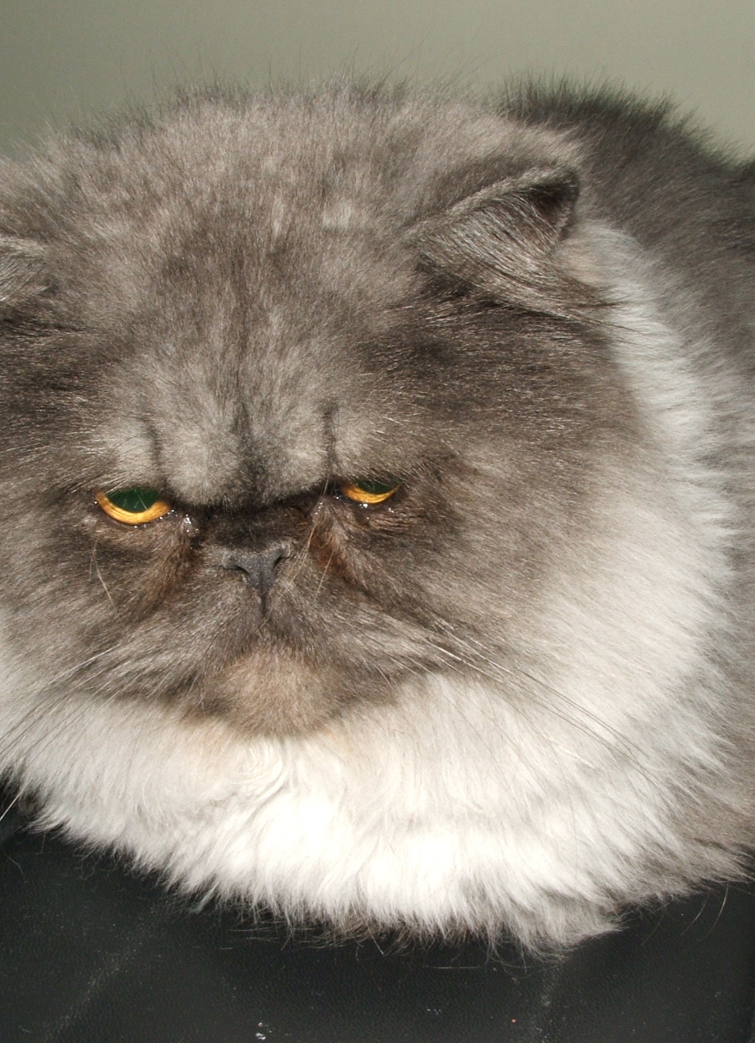
Persians have an extremely long thick coat, short legs, a wide head with the ears set far apart, large eyes, and an extremely foreshortened muzzle. very gentle and easy-going cats, adapting well to changing environments. Their hair is too long for them to groom themselves, so they do require daily brushing, or their hair gets matted and tangled.
The Russian blue has a lean medium-sized body and a short, plush, blue coat.
are highly intelligent and playful but tend to be shy around strangers. They also develop a close bond with their human companions.
Persian
Russian Blue

Slide 10
8. Of what benefit to man are domesticated cats?
Cats catch mice and provide friendship.
They are used in China and Japan to protect silkworm cocoons from rats.

Slide 11
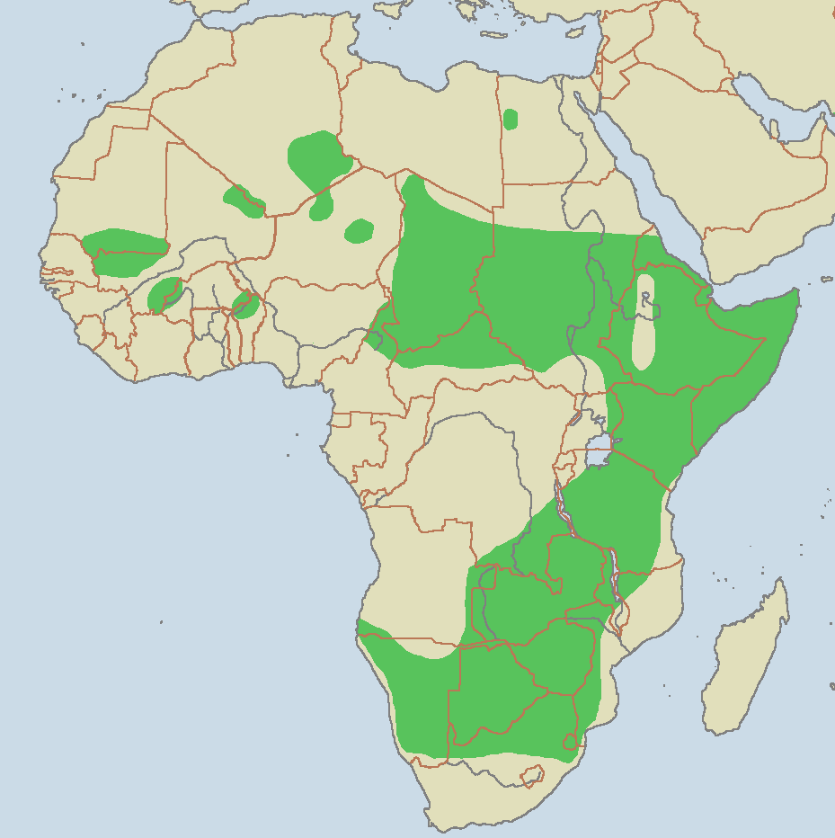
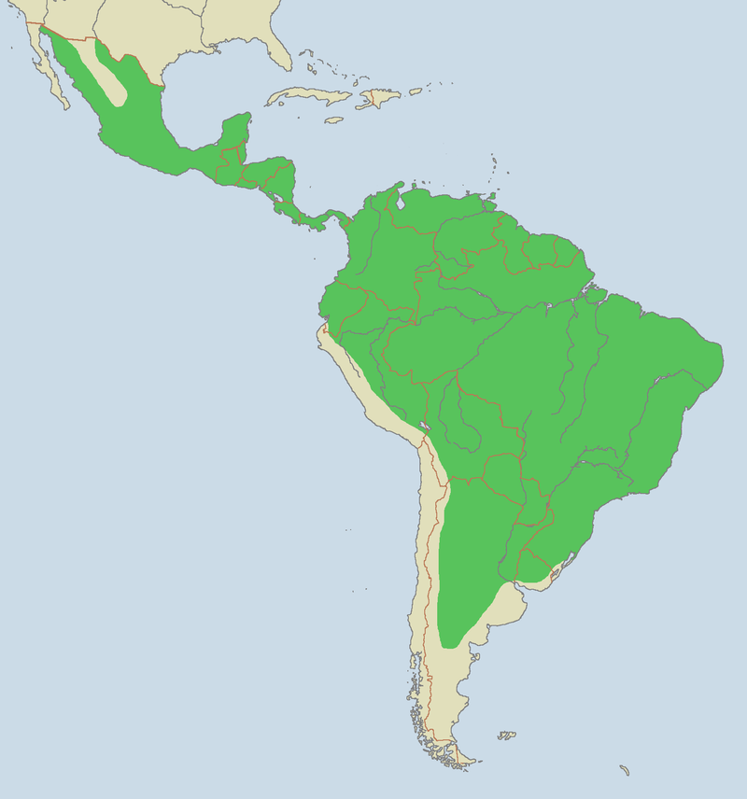
9. Identify from pictures or personal observation seven kinds of wild cats. Tell in what part of the world they are found.
Caracal
Places where cheetahs live are coloured green
Places where jaguars live are coloured green.

Slide 12
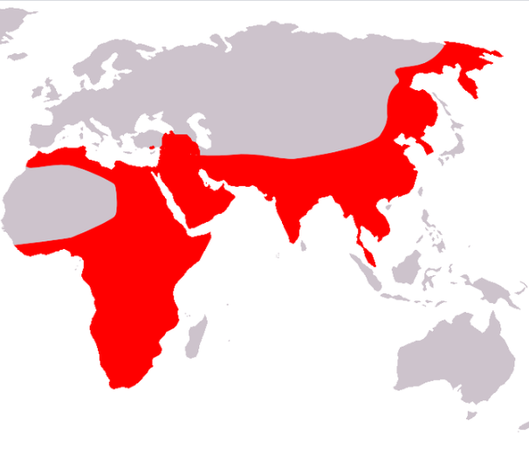
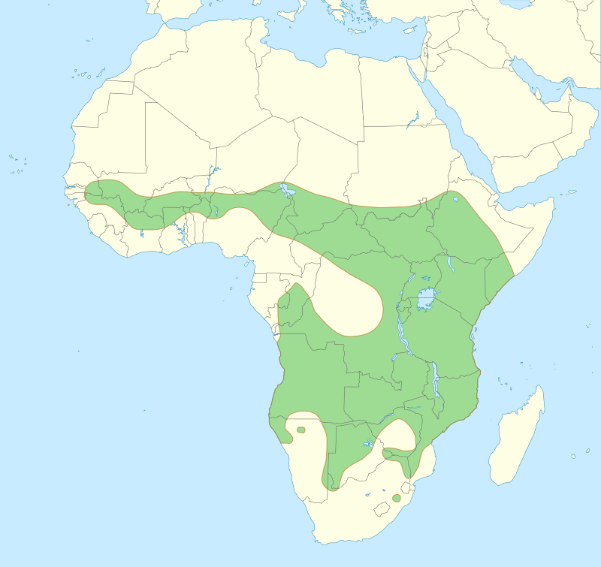
9. Identify from pictures or personal observation seven kinds of wild cats. Tell in what part of the world they are found.
Places where lions are seen are in green
Places where leopards are seen are in orange.

Slide 13
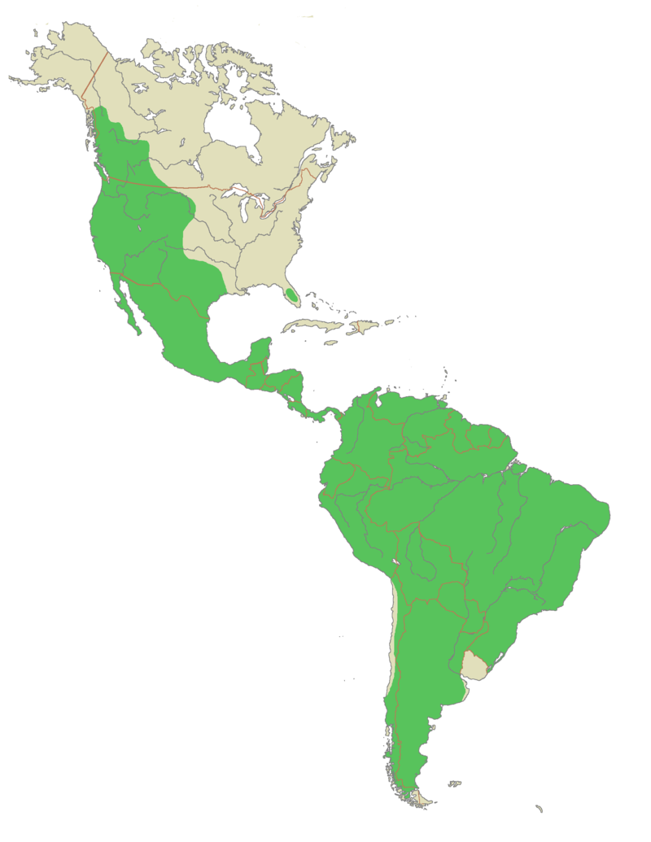
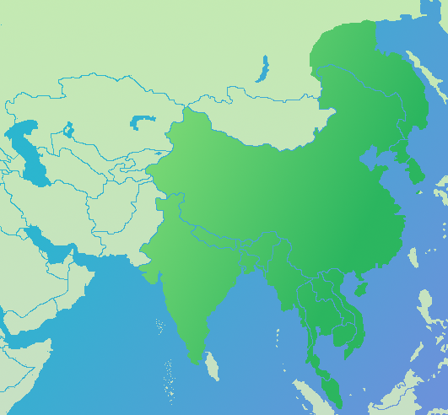
9. Identify from pictures or personal observation seven kinds of wild cats. Tell in what part of the world they are found.
Places where puma is seen are in green
Places where tigers live are marked in dark green.

Slide 14
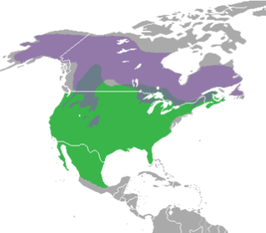
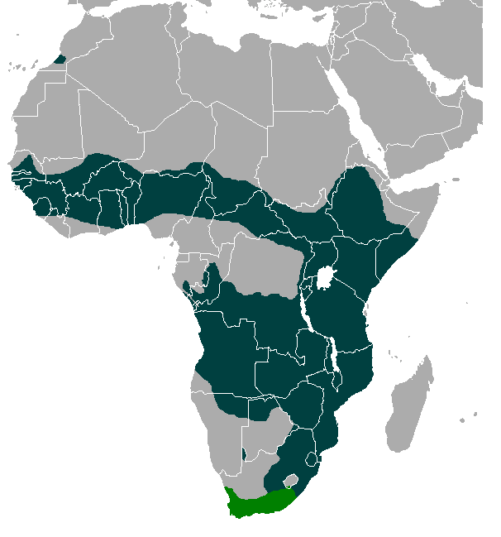
9. Identify from pictures or personal observation seven kinds of wild cats. Tell in what part of the world they are found.
Places where the Lynx comes from are in green.
Places where the Serval comes from are in green.

Slide 15
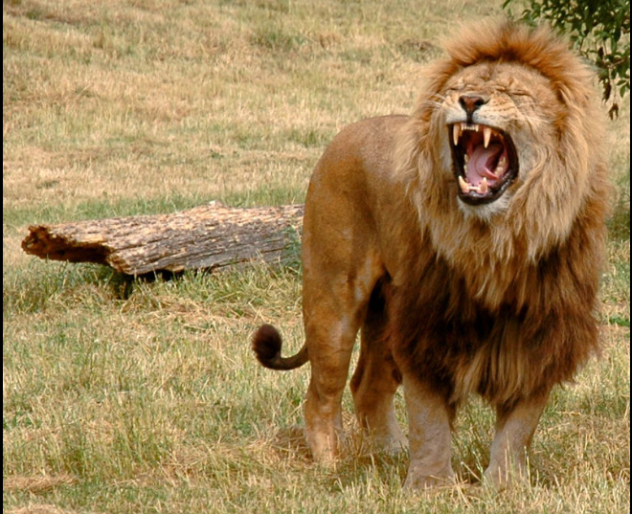
10. What animal is known as the king of beasts? Why does it have that title? What is it's temperament really like?
The lion is known as the king of the beasts.
The lion gets this distinction because it fears no other animal.
It is also said that the lion is named king of the beasts because of its courage and loyalty. Its courage cannot be doubted, but a lion is not particularly loyal.
Male lions are known to take over another male's pride of females by chasing away (or killing) the resident male(s).
They often form coalitions of two to five males and work together to oust other males. When they succeed in doing this, they then kill any cubs in the pride so that the females will be receptive to breeding sooner.
The females sometimes attempt to defend their cubs, but this is rarely met with success. These coalitions of males do not limit their activities to a single pride either.
A coalition may dominate several prides within their range. Not exactly a model of loyalty! (But then again, neither are human kings).

Slide 16
11. Tell the story of Androcles and the Lion.
https://www.youtube.com/watch?v=fjVmpfvfLAg

Slide 17
12. Relate four stories from the Bible in which a member of the cat family is mentioned.
Samson and the lion. (Judges 14)
David killed a lion and a bear (1 Samuel 17:36)
Lion killed a disobedient prophet. (1 Kings 13)
Benaiah killed a lion in a snowy pit. (1 Chronicles 11:22)
Calf and the lion will lie down together in heaven. (Isaiah 11:6,7)
Can a leopard change his spots? (Jeremiah 13:23)
Daniel and the Lion's Den (Daniel 6)
Daniel's dream of the lion with wings and leopard with four heads. (Daniel 7)

