Slide 1
Chemistry
FRIENDS

Slide 2
Definitions
ELEMENTS:
a species of a____ having the same number p_________ in its atomic nuclei
tom
rotons
PERIODIC TABLE:
a table of the c____________ e________ arranged in order of atomic number
hemical
lements
CHEMICAL SYMBOLS:
a________________ used in chemistry for chemical elements, functional groups and chemical compounds
bbreviations

Slide 3
Definitions
ATOMS:
the s____________ particle of a chemical element that can exist
mallest
MOLECULES:
a group of a______ bonded together
toms
COMPOUNDS:
a c__________ substance composed of many identical molecules
hemical

Slide 4
DEFINITIONS
PROTONS:
a subatomic particle, symbol p or p+, with a p__________ electric charge
ositive
NEUTRONS:
a s_____________ particle, symbol n, with no net electric charge
ubatomic
ELECTRONS:
a subatomic particle, symbol e minus, whose electric charge is n__________ 1
egative

Slide 5



Slide 6
definitions
SOLUTIONS:
a special type of m__________ composed of two or more substances
ixture
ACID:
a molecule or ion capable of donating a p________, or, alternatively capable of forming a covalent bond with an electron pair
roton
SALT:
a chemical compound consisting of an ionic assembly of cations and a_________
nions

Slide 7
DEFINITIONS
FILTRATION:
a physical, biological or chemical operation that separates solid matter and f__________
luid
DISTILLATION:
the process of a s____________ the components or substances from a liquid mixture by using selective boiling and condensation
COMBUSTION:
the process of b_________ something
FRACTIONAL DISTILLATION:
the separation of a mixture into its c___________ parts, or fractions
eparating
urning
hemical

Slide 9
WHAT GASES extinguish life? HOW?
1) Suffocation – The gas displaces oxygen and the body now starved of oxygen dies
2) Poison – There are gases such as Cyanide gas HCN which are highly poisonous
3) Explosion – Many gases are quite flammable and can explode quite destructively
Fire extinguishers work by smothering the fire

Slide 10
Carbon monoxide
GAS STOVES AND OVENS
CLOTHES DRYERS
IT IS HARMFUL WHEN BREATHED IN BECAUSE IT GETS RID OF OXYGEN IN THE BLOOD WHICH MEANS THERE IS LESS OXYGEN FOR THE HEART

Slide 11
States of matter

Slide 13
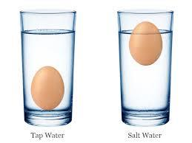
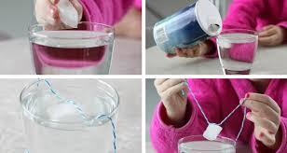
Experiment time!

Slide 14

Floating egg experiment

