Slide 1
Qualities of a good friend & good table manners

Slide 2
Rules
Cameras and audio on please
Participate
Write down what we discuss
Have fun

Slide 3
Qualities of a good friend (10min)
Loyal
Kind
Forgiving
Good listener
Patient
Honest
Supportive
Trustworthy
Caring
Respectful
Reliable
Selfless
Giving

Slide 4
Homework (5min brief)
Write down 4 circumstances where you have done to others as you would like them to do to you
E.g.
Being a friend to the new kid at school because you would like it if someone would do the same if
Helping your mum with cleaning because you like it when she helps you
Praying for others because you are grateful to your friends for praying for you

Slide 5
Table Manners (15 min)

Slide 6
Be clean and smart – wash hands and face
Be punctual (send message if running late)
Always ask if you can help
Do not eat before everyone receives their food
Do not chew with your mouth open
Do not talk with mouth full
Do not stuff your mouth (make face)
Don’t interrupt when people are speaking
Don’t reach over to get something
Say “thank you”
Push your chair back in when finished
Leave napkin on chair (not table)

Slide 7
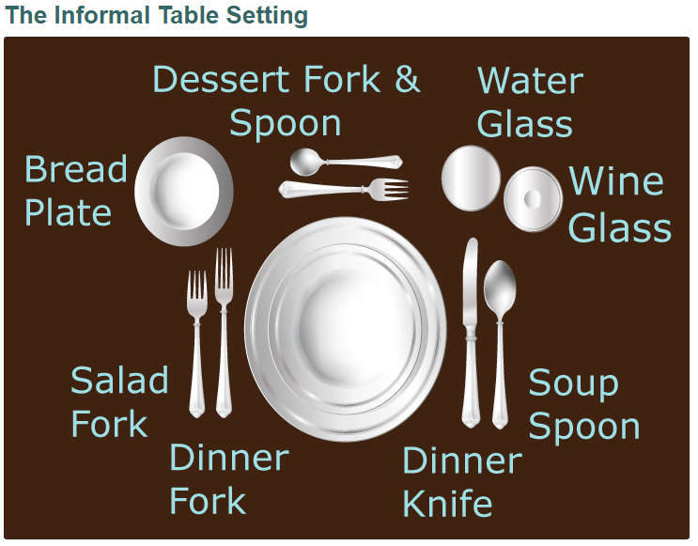

Slide 8
