Slide 1
STAY SAFE AT HOME

Slide 2
STAY SAFE AWARD
Psalms 139:13-14
Jeremiah 29:11
James 1:18
GOD CREATED YOU
HE CHOSE YOUR HAIR COLOUR, HEART AND PERSONALITY
HE LOVES YOU

Slide 3
STAY SAFE HOME ALONE
Obey the rules set by your parents
Remember what to do in an emergency.
Remember the time your parent are due back
Don’t open the door to anyone
Keep the door close and lock

Slide 4
PRACTICE ANSWERING THE PHONE
Never answer the phone by saying your first or last name.
If a caller asks your name, ask them who they wish to speak with, if the cannot name someone in your family, hand up.
DO not to give out personal information, like your name, address, telephone number, or which school you go too.

Slide 5
PRACTICE ANSWERING THE PHONE
If a caller ask, “what number is this?” ask them what number they are looking
Do not tell anyone you are home alone
DO NOT ACCEPT VIDEO CALLS

Slide 6
STAY SAFE ON THE INTERNET
Obey the rules set by your parents.
Do not chat with anyone
tell your parent about anything that happens on the internet

Slide 7
INTERNET
Don't post any personal information online – like your address, email address or mobile number.
Don’t post pictures or videos of yourself and your family
Never give out your passwords.
Don't befriend people you don't know.

Slide 8
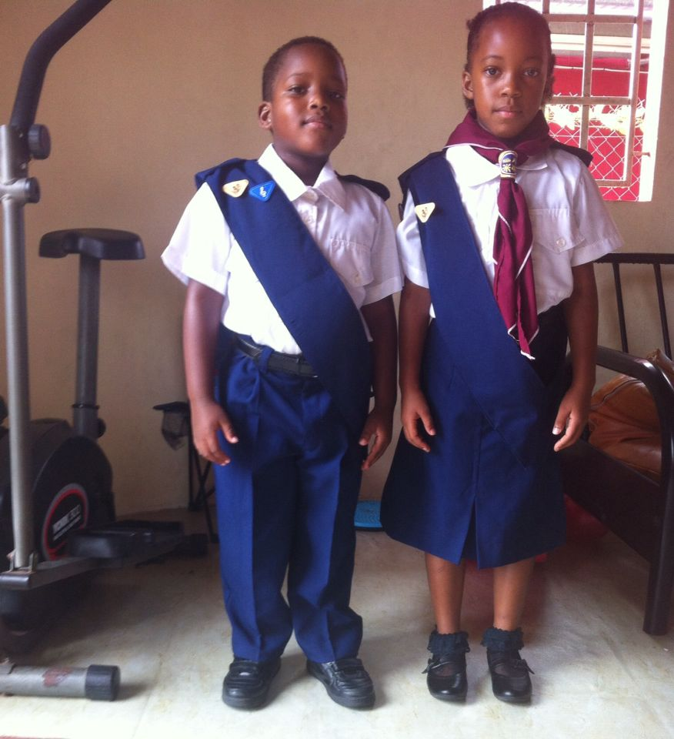
Safe and unsafe touch

Slide 9
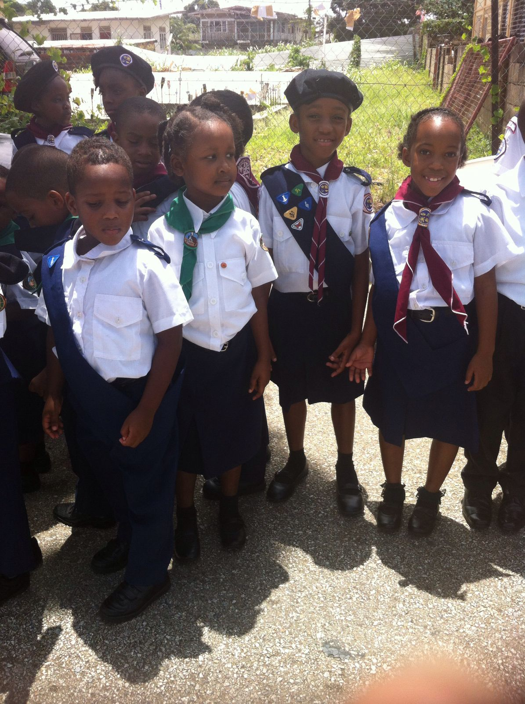
Keep a secret

Slide 10
Stranger Ask you to go with them
SAY NO
RUN AWAY
TELL YOUR PARENTS, A GROWN UP, TEACHER OR SOMEONE YOU TRUST

Slide 11
Stranger Ask you to go with them

Slide 12
ASK FOR HELP OR DIRECTIONS WANTS TO GIVE YOU SOMETHING

Slide 13
WHAT TO DO IF YOU GET LOST

Slide 14
What to do if you get lost
Check your location
Do not cry out because you will draw attention
Find any security station and ask for help
Do not follow strangers
Do not get distracted with playing with children
Run is someone pursue you

Slide 15
What to do if you get lost
Ask for help from a police officer, another grown-up with children or someone working at a nearby shop or food station

Slide 16
summary
We are Ambassadors for Christ … 2nd Corinthians 5:20

