Slide 1


Adventurer Club Award – Universe

Slide 2



Slide 3

What does the bible say about the universe and our planet earth?
How does the bible describe heaven?
Learn about the universe, galaxies, stars, planets, and our solar system.
Use the information to create a craft of the solar system.

Slide 4
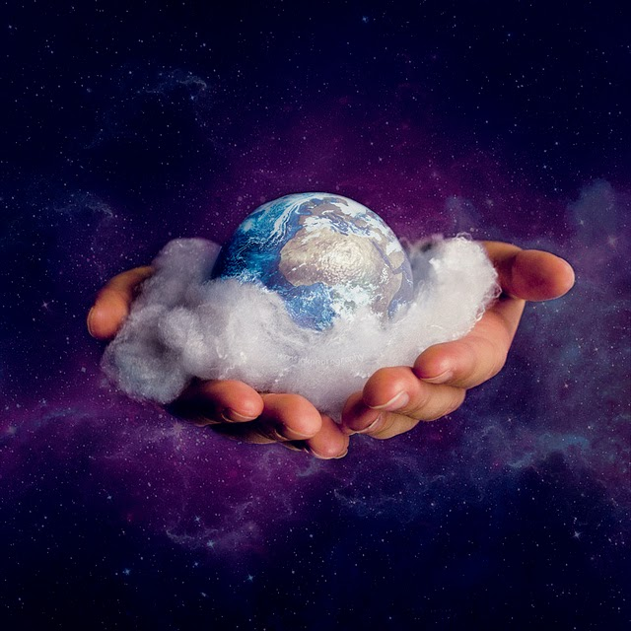
What does the bible say about the universe?
This Photo by Unknown Author is licensed under CC BY-ND

Slide 5
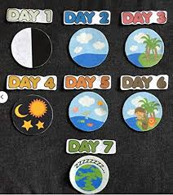
Genesis 1:1 – In the beginning God created the heavens and the earth

Slide 6
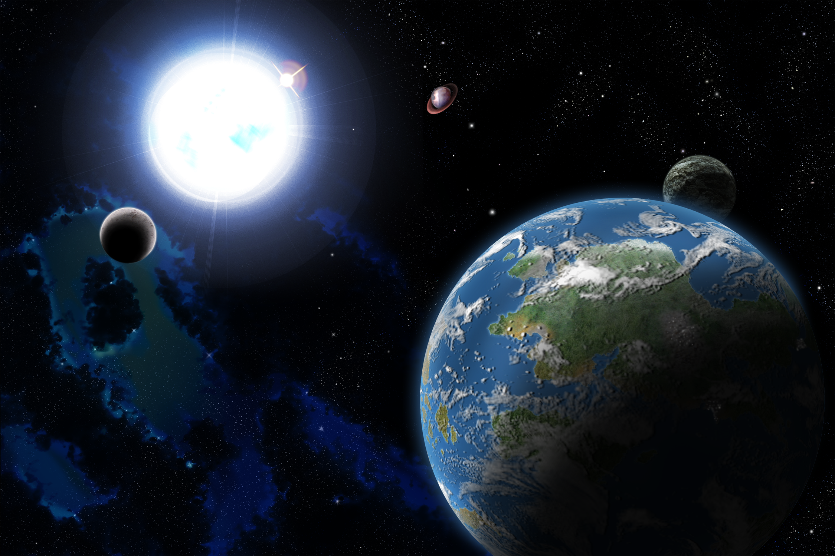
Isaiah 40:26 New King James Version (NKJV)
26 Lift up your eyes on high,
And see who has created these things,
Who brings out their host by number;
He calls them all by name,
By the greatness of His might
And the strength of His power;
Not one is missing.
This Photo by Unknown Author is licensed under CC BY

Slide 7
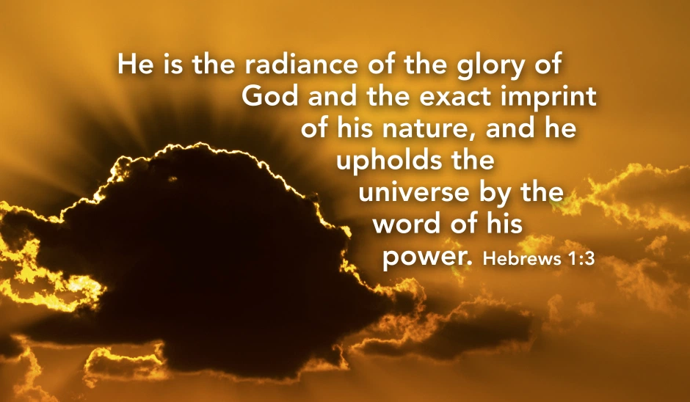

Slide 8

What does the bible say about heaven?

Slide 9
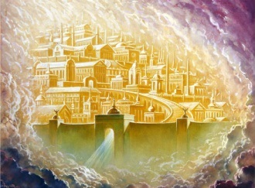
Revelation 21:2-3 New King James Version (NKJV)
2 Then I, [a]John, saw the holy city, New Jerusalem, coming down out of heaven from God, prepared as a bride adorned for her husband. 3 And I heard a loud voice from heaven saying, “Behold, the tabernacle of God is with men, and He will dwell with them, and they shall be His people. God Himself will be with them and be their God.

Slide 10
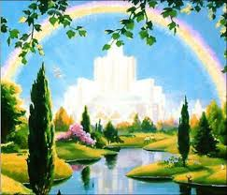
The River of Life
22 And he showed me a [a]pure river of water of life, clear as crystal, proceeding from the throne of God and of the Lamb. 2 In the middle of its street, and on either side of the river, was the tree of life, which bore twelve fruits, each tree yielding its fruit every month. The leaves of the tree were for the healing of the nations.
5 There shall be no night there: They need no lamp nor light of the sun, for the Lord God gives them light. And they shall reign forever and ever.
Revelation 22:1-2, 5

Slide 11


Activity:
After reading Revelation 21 & 22, what do you think Heaven will be like?
Draw a picture of your view of Heaven.

Slide 12
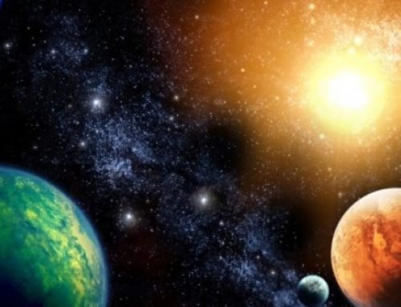
What does the bible say about the universe, stars, moon, planets, and/or sun?

Slide 13
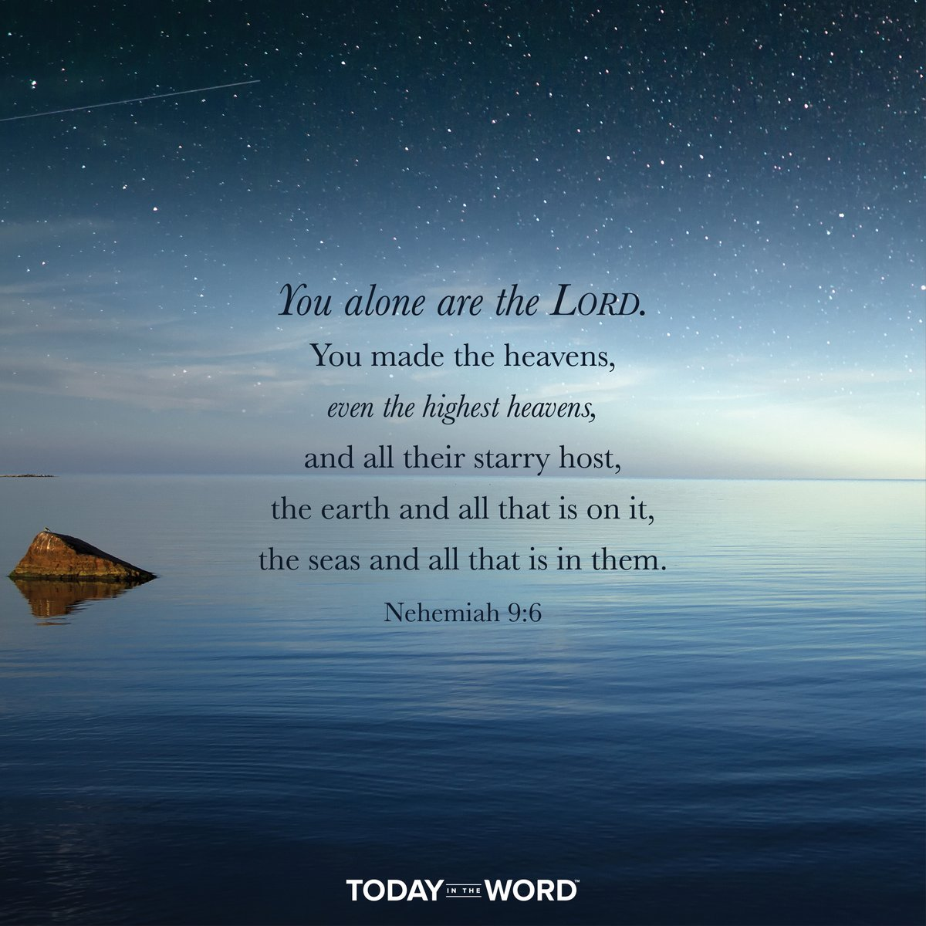

Slide 14
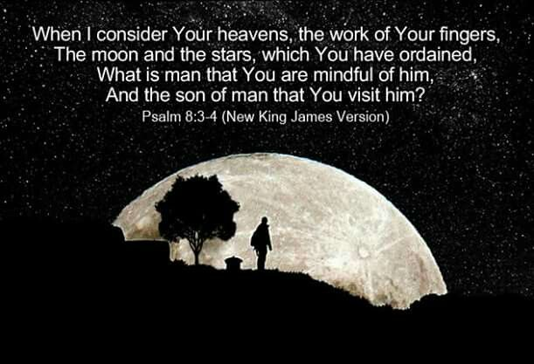

Slide 15
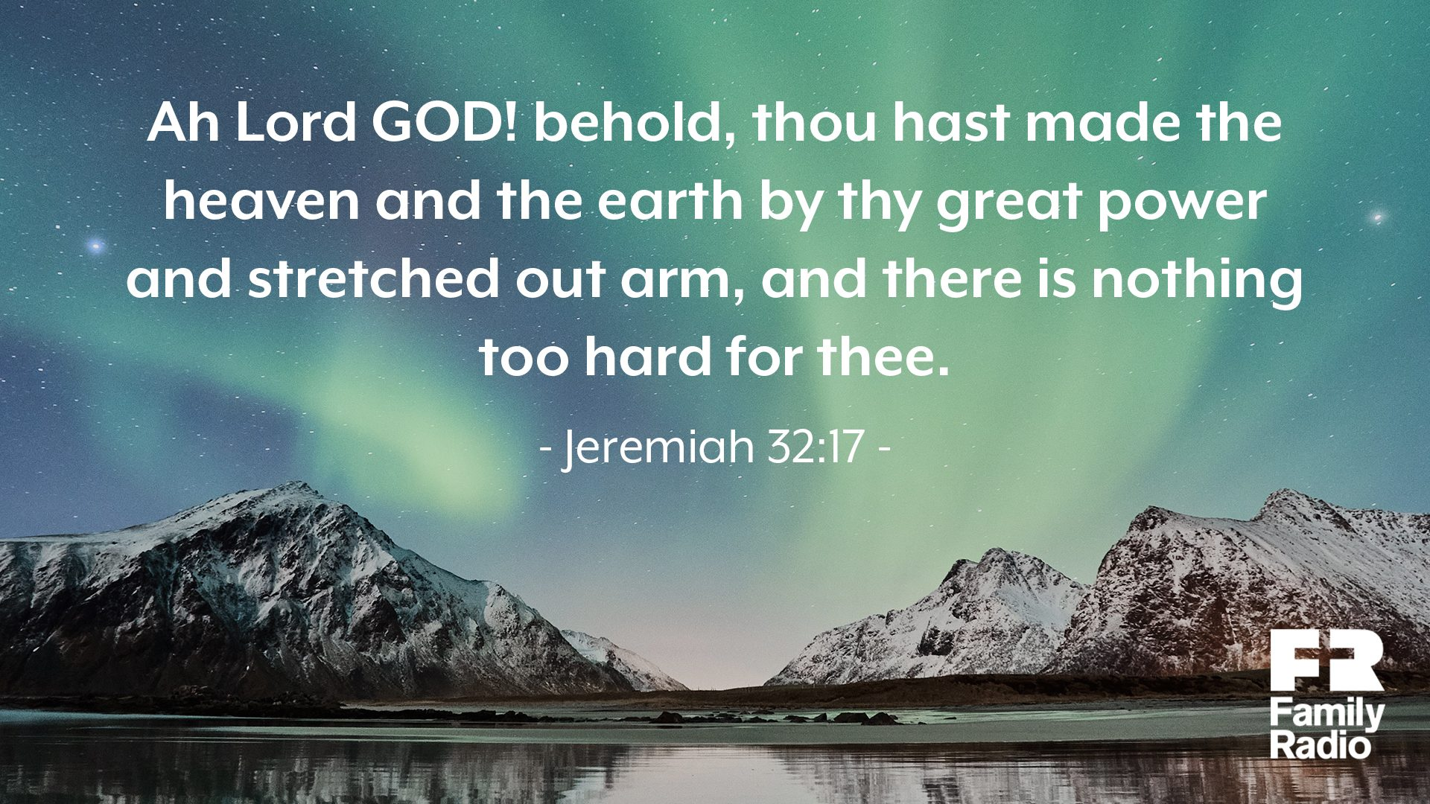

Slide 16
What are the main Celestial bodies?
Note: Celestial means positioned in or relating to the sky

Slide 17
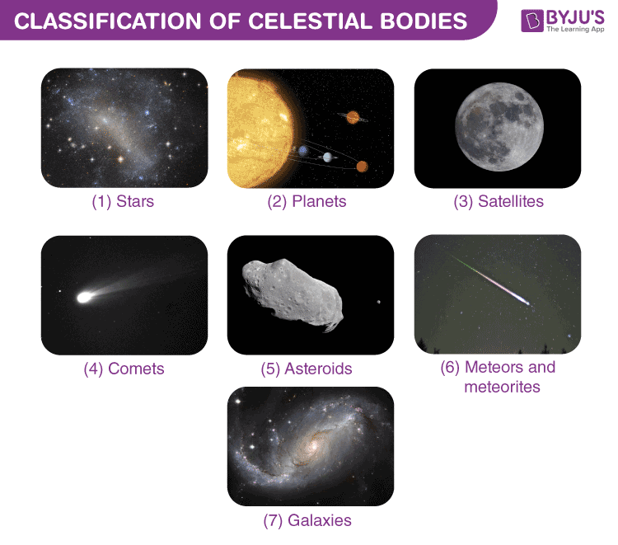

Slide 18
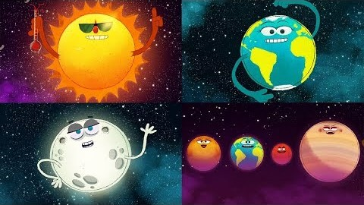

Slide 19


Slide 20
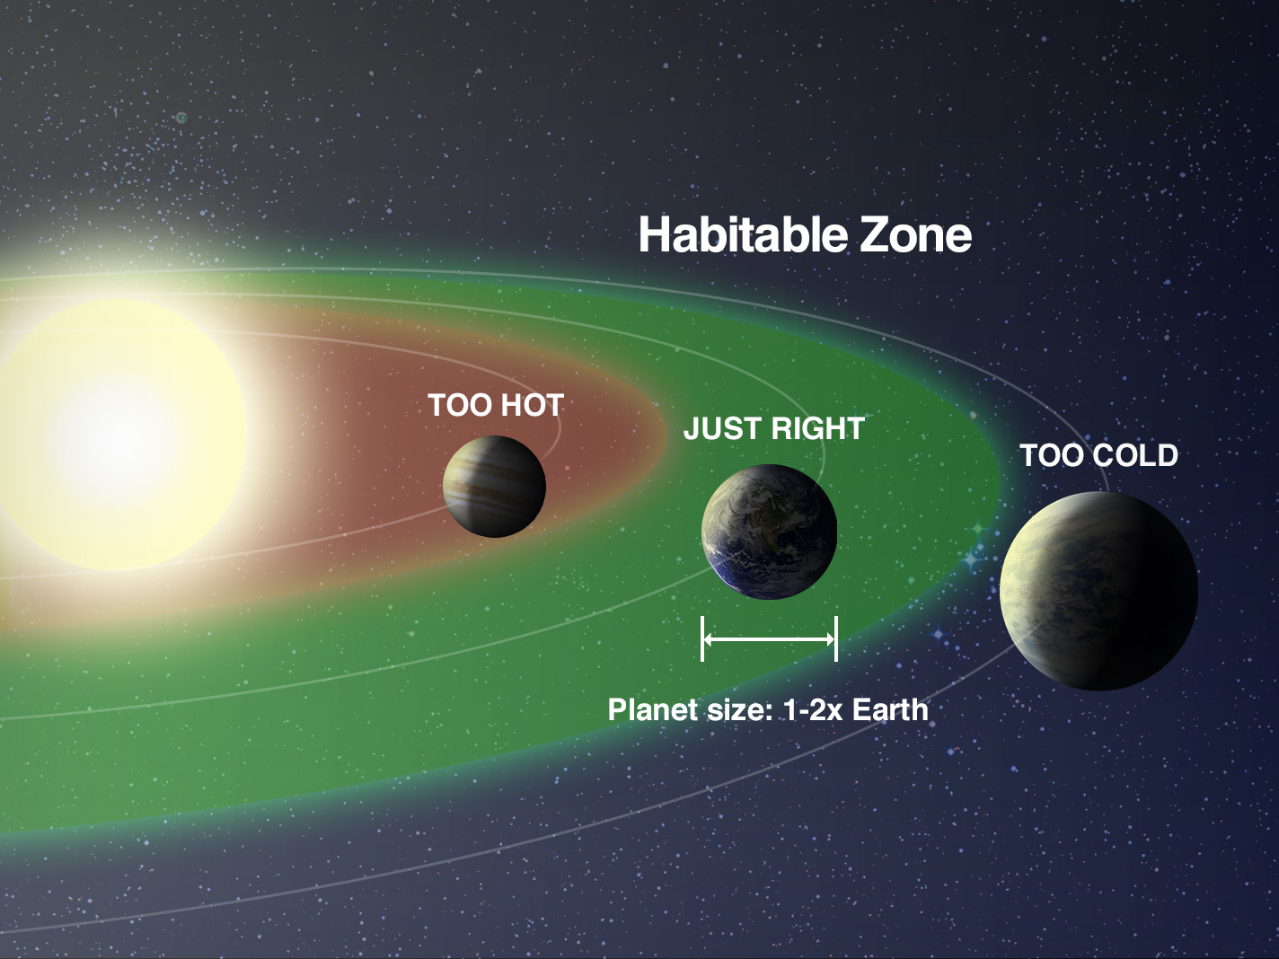
The habitable zone is the not-too-hot, not-too-cold region around a star where liquid water can exist on a planet’s surface.

Slide 21
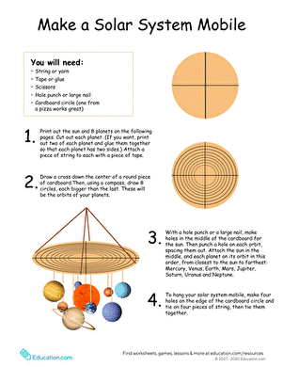
Activity:
Create a solar system mobile with the help of your parents.

Slide 22
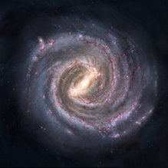
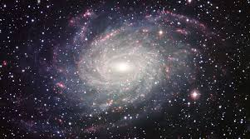
The Milky Way is the name given to the Galaxy our
Solar System is located in.

Slide 23


Slide 24


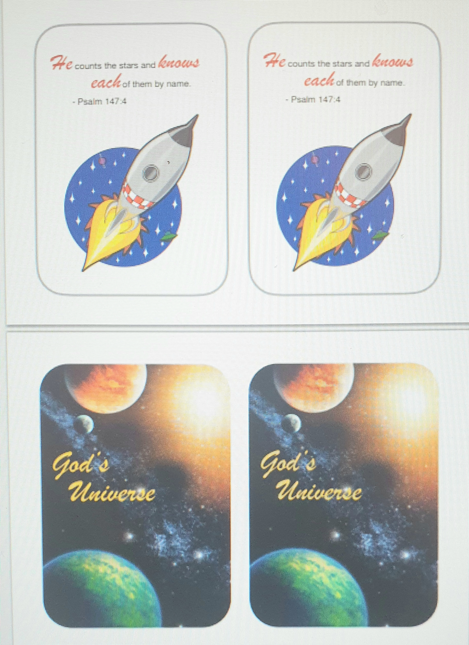
Activity: Play a space game!
Meteor water balloon fight
Bible verse memory game

Slide 25

We learned what the bible says about who created the universe
2.We learned about what heaven is like
3.We learned about galaxies, stars, planets, satellites, meteors, meteorites and comets.
4.We learned about our solar system and the names of the planets

