Slide 1
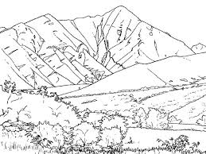
Spotter Award

Slide 2
GUESS THE ANIMAL
1
2
3
4
5
6
7
8
9
10
11
12

Slide 3
GUESS THE ANIMAL
1
2
3
4
5
6
7
8
9
11
12
10

Slide 4
GUESS THE ANIMAL
1
2
3
4
5
6
7
8
9

Slide 5
GUESS THE ANIMAL
1
2
3
4
5
6

Slide 6
GUESS THE VEHICLE
1
2
3
4
5
6
7

Slide 7
GUESS THE VEHICLE
2
1
3
4
5
6
7
8
9
10

Slide 8
GUESS THE VEHICLE
3
1
2
4
7
5
6

Slide 9
GUESS THE VEHICLE
1
3
2
6
4
5
9
7
8

Slide 10
What can you see?
What is different?

Slide 11
What can you see?
Can you spot 4 different nature items?

Slide 12
What can you see?
Can you spot 4 different birds?

Slide 13
UNIFORMED WORKERS

Slide 14
Find this verse: Matthew 28:20
‘ “Teaching them to observe all things that I have commanded you; and lo, I am with you always, even to the end of the age.” Amen’

Slide 15
How can you help to keep you church clean?
Picking up litter
Straightening hymn book and Bibles
Making sure shoes are clean when walking through church

Slide 16
What’s the difference?
Dirty
Unsatisfying
Untidy
Organised
Easy to find things
Tidy

Slide 17
Memory Game
You have 2 minutes to remember as many items as you can…

Slide 18
How many items can you remember?

