Slide 2
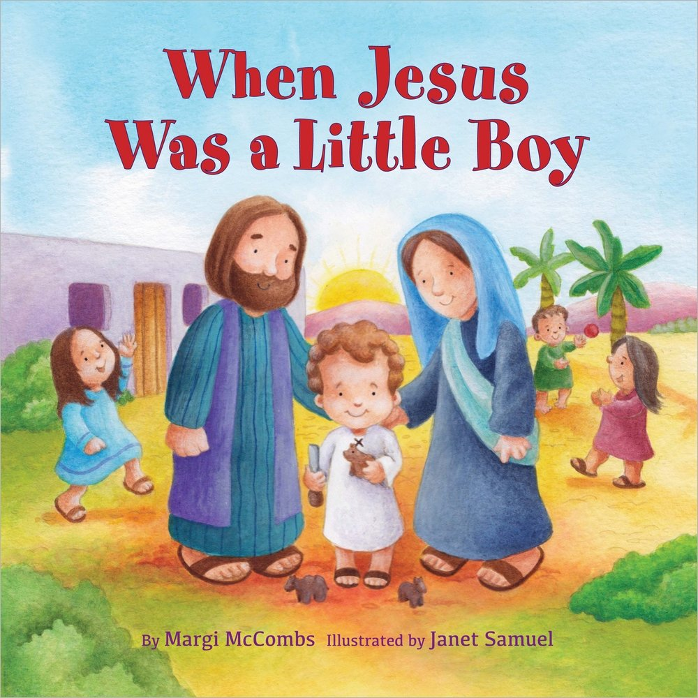
Story title and song title

Slide 3
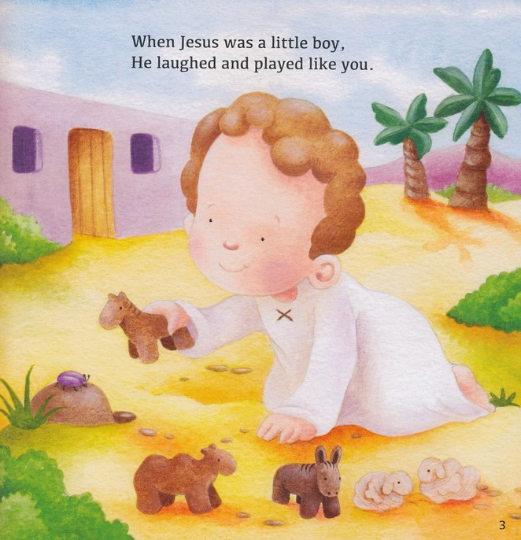

Slide 4
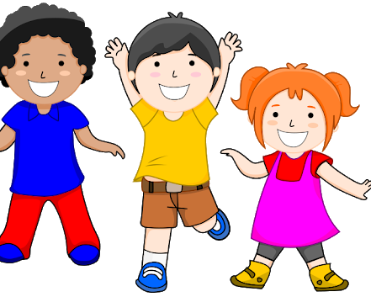

Slide 11
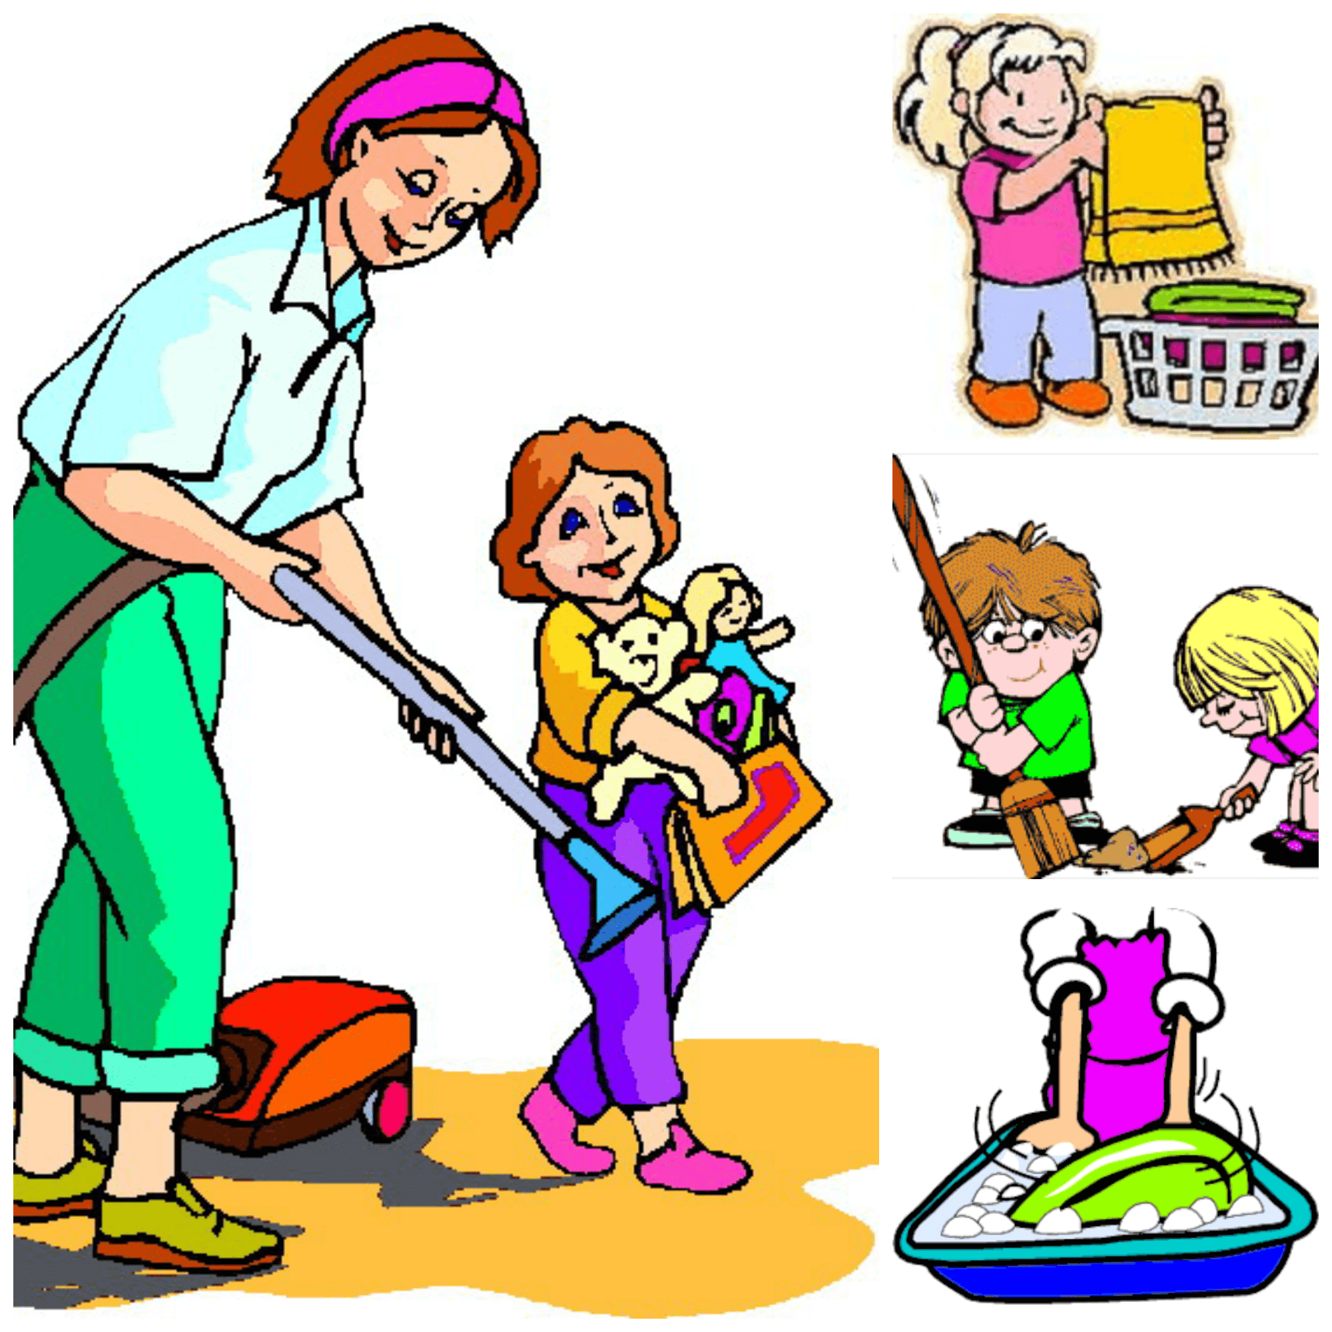

Slide 12
I want be like Jesus (2X) Kind and true and Helpful I want be like jesus

Slide 13
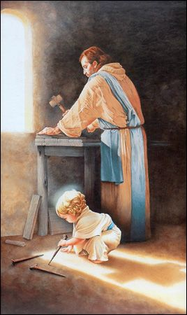
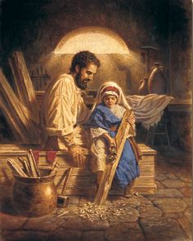
Helping as Jesus game

Slide 14
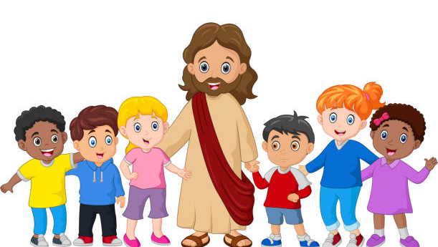
When Jesus was a little boy - He lived in Galilee
He climbed the hills and played with friends - And laughed like you and me

Slide 15
He learned to be a carpenter – and help his mommy with the chores
He learned some lessons just like me – and probably got some bumps and sores

