Slide 1
First aid explorer
First aid explorer
Area 8 pathfinders e-camp 5 April 2021
By Rajeena Hansdak

Slide 2
SUNBURN
sunburn can be treated at home with:
Cool compresses
Over-the-counter pain medications, Aloe vera gel or lotion
Hydration - drinking plenty of fluids

Slide 3
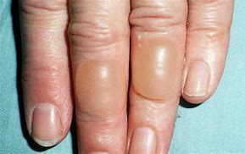
BURNS
The term “burn” means more than the burning sensation associated with this injury. Burns are characterized by severe skin damage that causes the affected skin cells to die.

Slide 4
https://youtu.be/Ns1DPvXVO6I

Slide 5
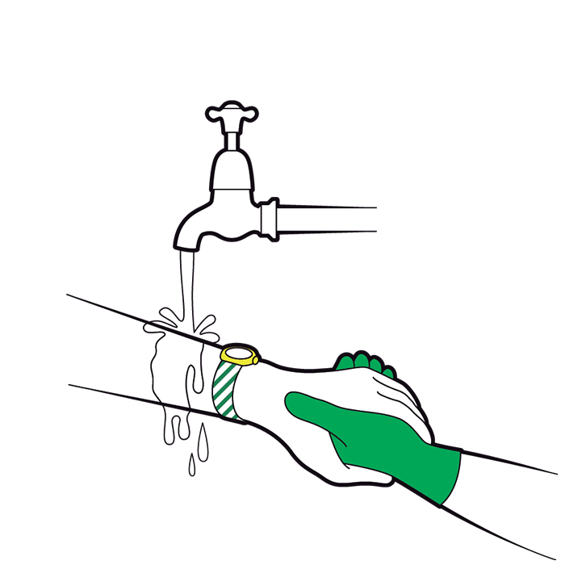
Start cooling the burn or scald as quickly as possible. Hold it under cool running water for at least 20 minutes or until the pain feels better.
If there is no water available, you could use cold milk or canned drinks.

Slide 6
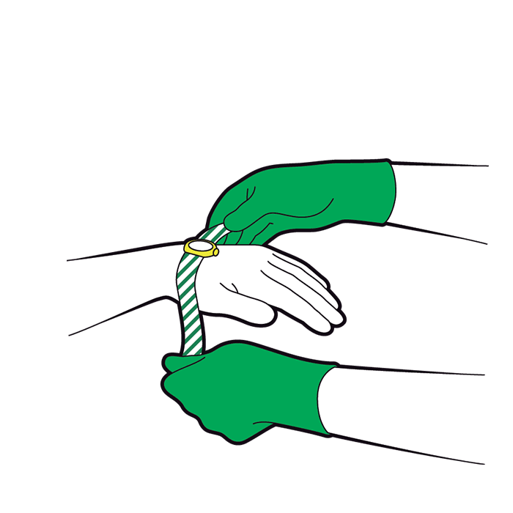
Remove any jewellery or clothing, unless stuck to the burn, before the area begins to swell.

Slide 7
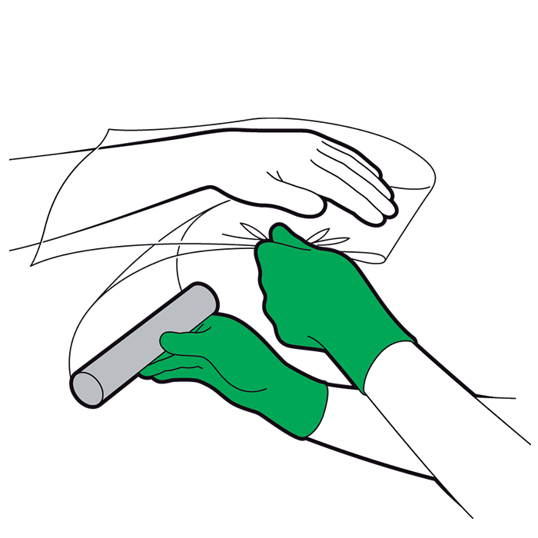
When the burn has cooled, cover the area loosely with cling film, lengthways.

Slide 8
Do not wrap the cling film around the burn as the area needs space to swell.
If the burn is on a foot or hand you could use a clean plastic bag.
Do not use ice, creams or gels. They may cause damage and increase the risk of infection.
Do not break any blisters that may appear, as this may cause infection.

Slide 9
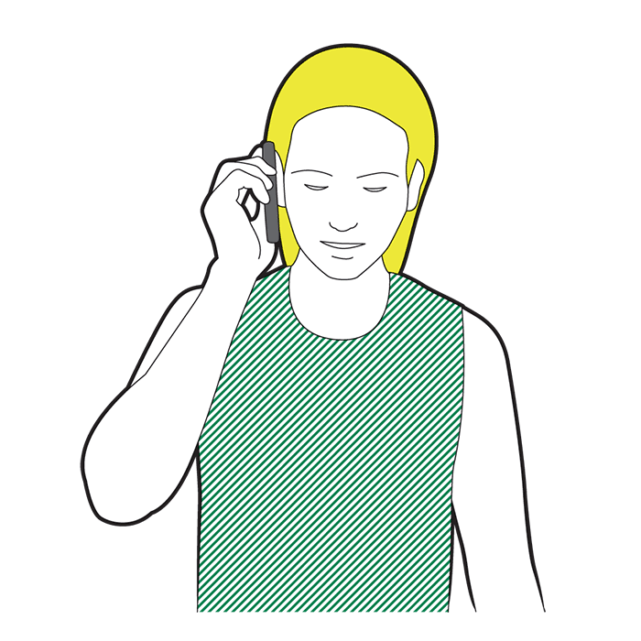
Monitor the casualty. Seek medical advice!!

Slide 10
SMOKE IN THE EYES
Over-the-counter artificial tears.
.
Cool your eyes. Stay indoors..
Wear glasses or goggles. Improve your indoor air with an air filter.

Slide 11
SMOKE INHAILATION
signs and symptoms of smoke inhalation :
Cough and hoarseness
Chest pain or coughing up blood
Trouble breathing, such as shortness of breath and noisy breathing
Headache, abdominal pain, and nausea
Eye irritation or vision problems
Fainting
Soot in your nostrils or throat

Slide 12
SMOKE INHAILATION
How is smoke inhalation treated?
Antidotes: These are substances that may stop or control the effects of the smoke you inhaled. Healthcare providers may give different antidotes depending on the type of smoke you inhaled.
Bronchodilators:
Steroids: Steroid medicine may help to open your air passages so you can breathe easier.
Antibiotics: This medicine is given to help treat or prevent an infection caused by bacteria.
Medicines to treat pain, swelling, or fever:

Slide 13
https://youtu.be/eXmOTIsesBk

Slide 14
UNCONCIOUSNESS
Unconsciousness is when a person suddenly becomes unable to respond to stimuli and appears to be asleep. A person may be unconscious for a few seconds — as in fainting — or for longer periods of time.
Common causes of unconsciousness include:
a car accident
severe blood loss
a blow to the chest or head
a drug overdose
alcohol poisoning

Slide 15
UNCONCIOUSNESS
Check whether the person is breathing. If they’re not breathing, have someone call 999 or your local emergency services immediately and prepare to begin CPR. If they’re breathing, position the person on their back.
Raise their legs at least 12 inches above the ground.
Loosen any restrictive clothing or belts. If they don’t regain consciousness within one minute, call 911 or your local emergency services.
Check their airway to make sure there’s no obstruction.
Check again to see if they’re breathing, coughing, or moving. These are signs of positive circulation. If these signs are absent, perform CPR until emergency personnel arrive.
If there’s major bleeding occurring, place direct pressure on the bleeding area or apply a tourniquet above the bleeding area until expert help arrives.

Slide 16
Fainting
Imbalance of heat
Shock
Head injury
Stroke
Heart attack
Asphyxia
Epilepsy
diabetes

Slide 17
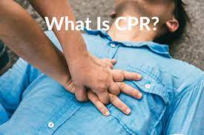

Slide 19
https://youtu.be/Q_QPCauSmvc

Slide 20
https://youtu.be/y52c9ebL-Wo

Slide 21
CPR
How do you perform CPR?
CPR is a way to treat someone when they stop breathing or their heart stops beating.
If a person stops breathing, call your local emergency services or ask someone else to. Before beginning CPR, ask loudly, “Are you OK?” If the person doesn’t respond, begin CPR.
Lay the person on their back on a firm surface.
Kneel next to their neck and shoulders.
Place the heel of your hand over the center of their chest. Put your other hand directly over the first one and interlace your fingers. Make sure that your elbows are straight and move your shoulders up above your hands.
Using your upper body weight, push straight down on their chest at least 1.5 inches for children or 2 inches for adults. Then release the pressure.

Slide 22
Repeat this procedure again up to 100 times per minute. These are called chest compressions.
To minimize potential injuries, only those trained in CPR should perform rescue breathing. If you haven’t been trained, perform chest compressions until medical help arrives.
If you’re trained in CPR, tilt the person’s head back and lift the chin to open up the airway.
Pinch the person’s nose closed and cover their mouth with yours, creating an airtight seal.
Give two one-second breaths and watch for their chest to rise.
Continue alternating between compressions and breaths — 30 compressions and two breaths — until help arrives or there are signs of movement.

Slide 23
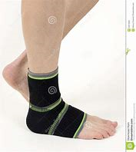
CONSTRICTIONS AND RESTRICTIVE BANDAGES
constrictive bandage
dressing applied to restrict joint movement, prevent oedema formation or control bleeding
bandage is a piece of material used either to support a medical device such as a dressing or splint, or on its own to provide support to or to restrict the movement of a part of the body. When used with a dressing, the dressing is applied directly on a wound, and a bandage used to hold the dressing in place.

Slide 24
https://youtu.be/0jps5SZlTdo

Slide 25
https://youtu.be/SztsZNp-jDM

Slide 26
https://youtu.be/767Zqfw4xqU

Slide 27
SNAKE BITE
Some snakes are venomous and can inject venom containing toxins as they bite. A bite from a venomous snake is a medical emergency because it can be deadly if not treated quickly.

Slide 28
SNAKE BITE
What to do after a snake bite
Immediately after being bitten by a snake you should:
remain calm and don't panic – snake bites, particularly those that occur in the UK, usually aren't serious and are only very rarely deadly
try to remember the shape, size and colour of the snake
keep the part of your body that's been bitten as still as possible to prevent the venom spreading around your body
remove jewellery and watches from the bitten limb as they could cut into your skin if the limb swells

Slide 29
do not attempt to remove any clothing, but loosen clothing if possible
seek immediate medical attention
If you or someone you're with is bitten by a snake, you should NOT:
try to suck the venom out of the bite
try to cut the venom out of the bite or make it bleed
rub anything into the wound or apply ice, heat or chemicals
leave someone who's been bitten on their own
put anything around the bitten limb to stop the spread of venom (such as a tight pressure band, tourniquet or ligature) as it won't help, and can cause swelling or make it worse; it could also damage the limb, leading to the need for amputation
try to catch or kill the snake

Slide 30
https://youtu.be/DFFzJIy-ak8

Slide 31
BITES AND STINGS
Wasp and hornet stings
A wasp or hornet sting causes a sudden, sharp pain at first. A swollen red mark may then form on your skin, which can last a few hours and may be painful and itchy.
Sometimes a larger area around the sting can be painful, red and swollen for up to a week. This is a minor allergic reaction that isn't usually anything to worry about.
A few people may experience a serious allergic reaction (anaphylaxis), causing breathing difficulties, dizziness and a swollen face or mouth. Dial 999 for an ambulance immediately if you have these symptoms.

Slide 32
BEE STING
bee sting feels similar to a wasp sting, but the sting will often be left in the wound. See treating insect bites for advice about how to remove this safely.
The sting can cause pain, redness and swelling for a few hours. As with wasp stings, some people may have a mild allergic reaction that lasts up to a week.
Serious allergic reactions can also occasionally occur, causing breathing difficulties, dizziness and a swollen face or mouth. Dial 999 for an ambulance immediately if you have these symptoms.

Slide 33
https://youtu.be/wVk76y_zJd8

Slide 34
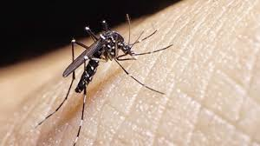
MOSQUITO BITE
Bites from mosquitoes often cause small red lumps on your skin. These are usually very itchy. Some people may also develop fluid-filled blisters.
Mosquitoes don't cause major harm in the UK, but in some parts of the world they can spread serious illnesses such as malaria.
Get medical help right away if you develop worrying symptoms, such as a fever, chills, headaches and vomiting, after a mosquito bite abroad.

Slide 35
https://youtu.be/reKlLpbTHFs

Slide 36
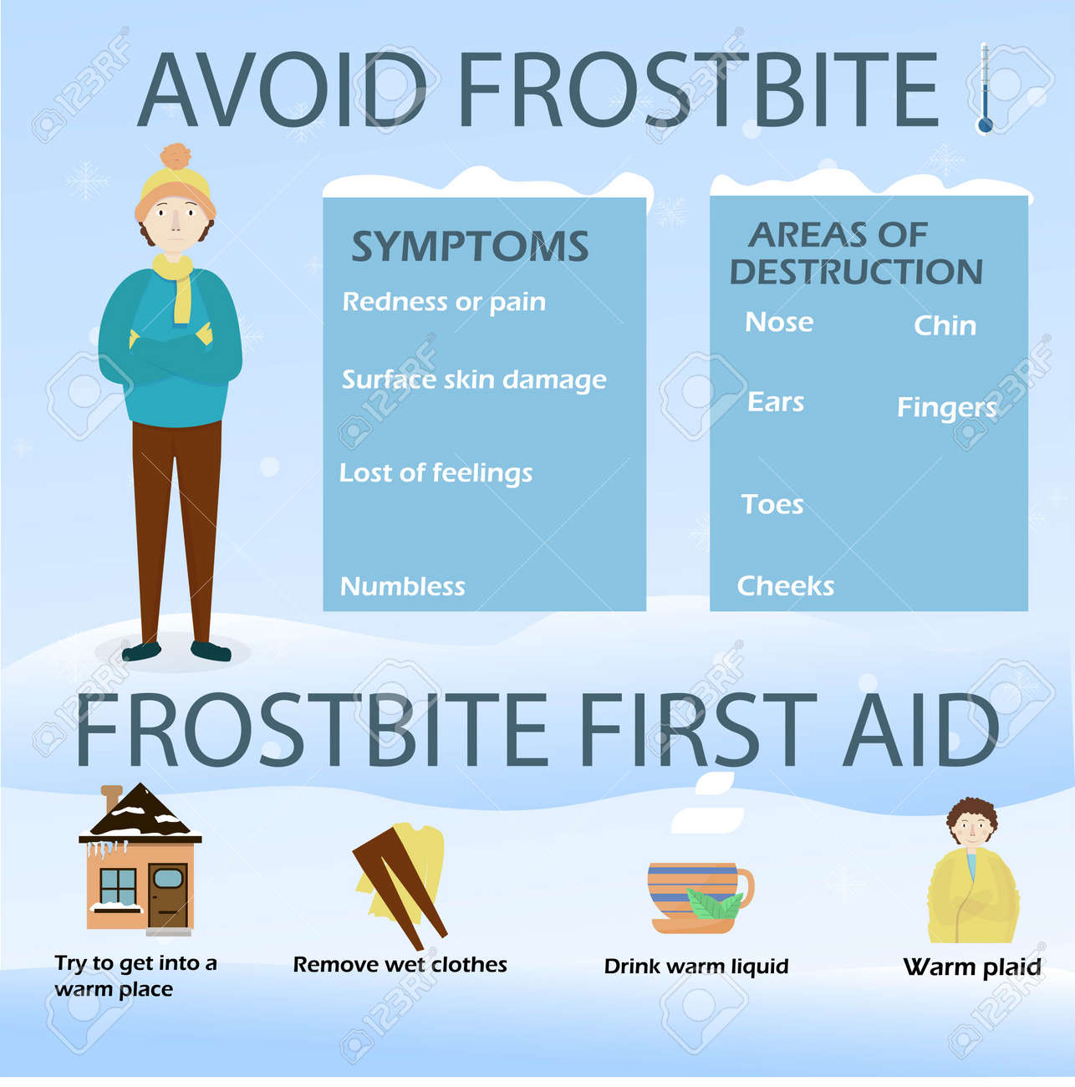
COLD AND FROSTBITE!

Slide 37
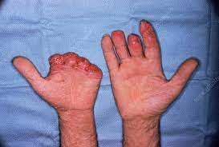
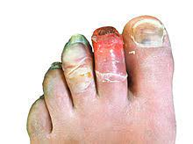

Slide 38
EXPLOSURE TO COLD CONDITIONS FROSTBITE
First aid for frostbite, as well as immersion or trench foot, includes:
Check for signs of hypothermia and seek medical attention. If necessary quickly transport the victim to an emergency care facility.
Treat the person gently and monitor breathing.
If possible, move the victim to a warm area.
Remove wet clothing, and gently loosen or remove constricting clothing or jewellery that may restrict circulation.

Slide 39
Warm the person by wrapping them in blankets or by them putting on dry clothing. Cover the head and neck. Warm the person slowly. Avoid direct heat which can burn the skin.
Loosley cover the affected area with a sterile dressing. Place some gauze between fingers and toes to absorb moisture and prevent them from sticking together.
If the person is alert, give them warm liquids to drink.
DO NOT attempt to rewarm the affected frostbite area on site (but do try to stop the area from becoming any colder) - without the proper medical care, tissue that has been warmed may refreeze and cause more damage.
DO NOT rub area or apply dry heat.
DO NOT allow the victim to drink alcohol or smoke.

Slide 40
https://youtu.be/e3eimijVeLw

Slide 42
Thank You So Much For Your Participations!
Be Alert And Be Safe!!
God Bless!!

