Slide 1
Nature Study

Slide 2
Review the story of the flood
Genesis 6-9

Slide 3
Study at least three different fossils

Slide 4
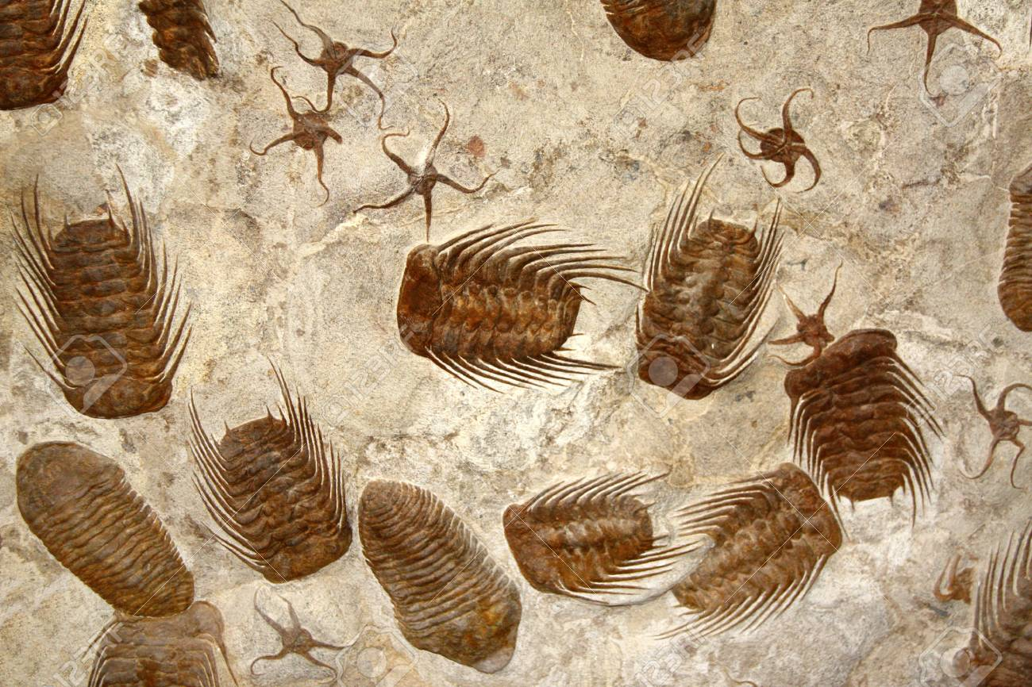
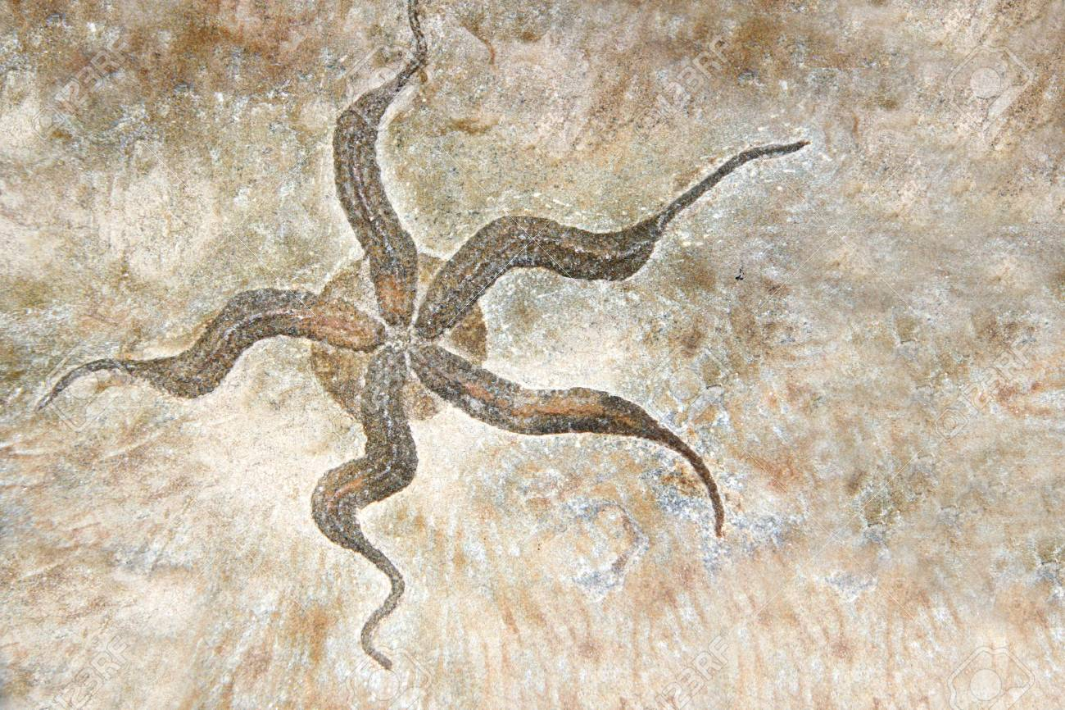
Petrified fossils
Petrified fossils form when minerals replace the structure of an organism.

Slide 5
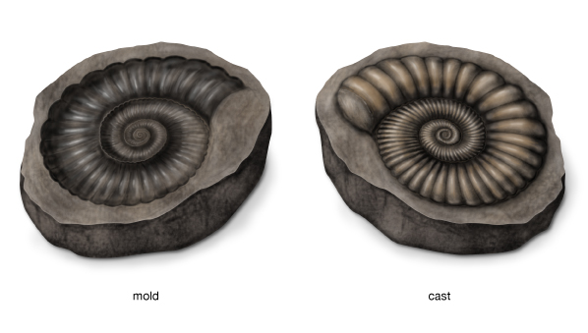
Molds and casts
Fossil molds and casts preserve a three-dimensional impression of remains buried in sediment. The mineralized impression of the organism left in the sediment is called a mold. The mineralized sediment that fills the mold recreates the shape of the remains. This is called a cast.

Slide 6
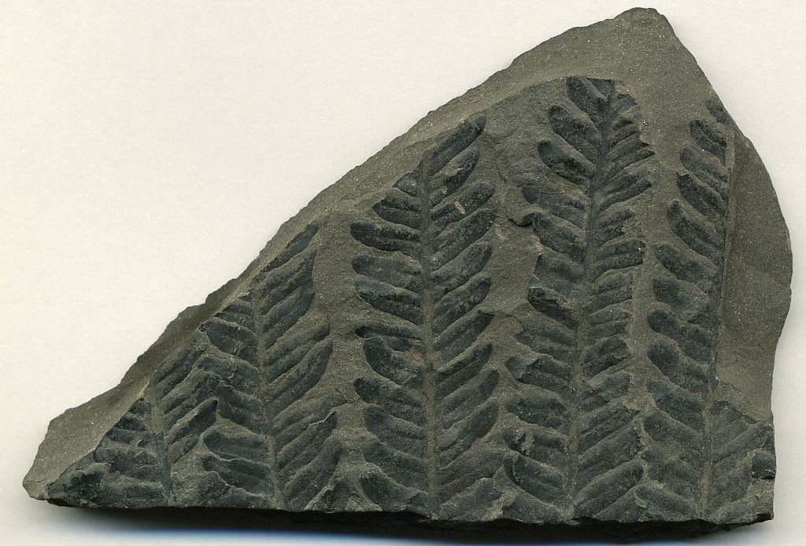
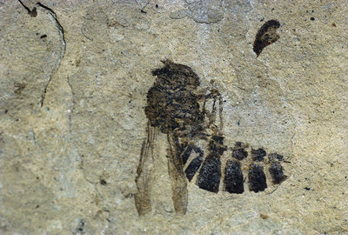
Carbon film
Carbon film fossils form when dead organisms are squeezed between layers of rock. This leaves behind the organism's carbon imprint in the rock.

Slide 7
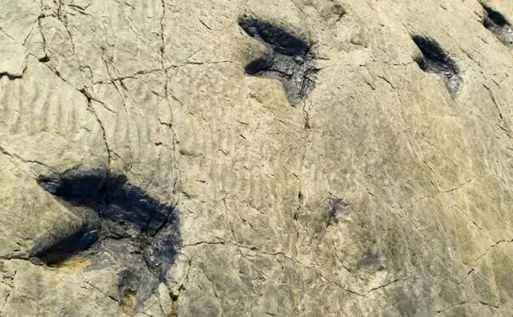
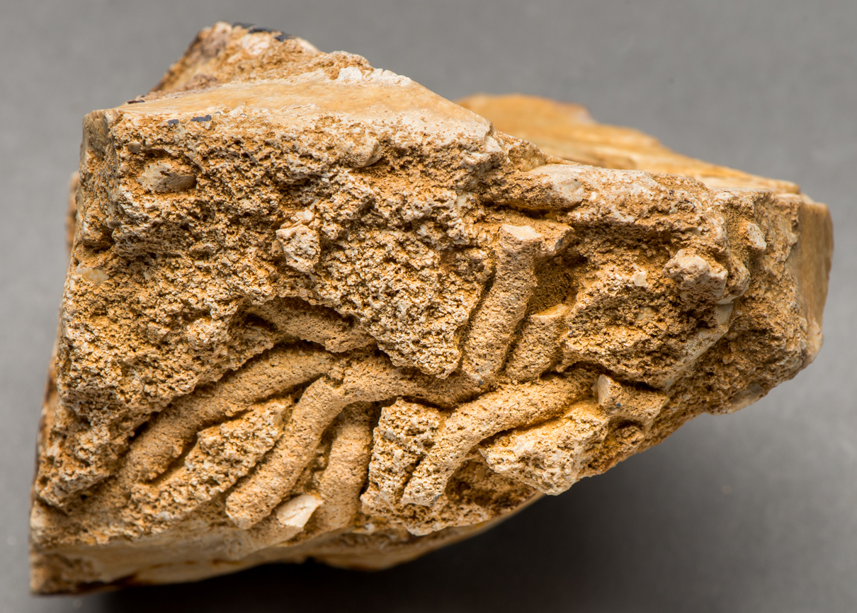
Trace fossils
trace fossils are geological records of the activities and behaviors of past life. Some examples include rock evidence of nests, burrows, footprints, and droppings.

Slide 8
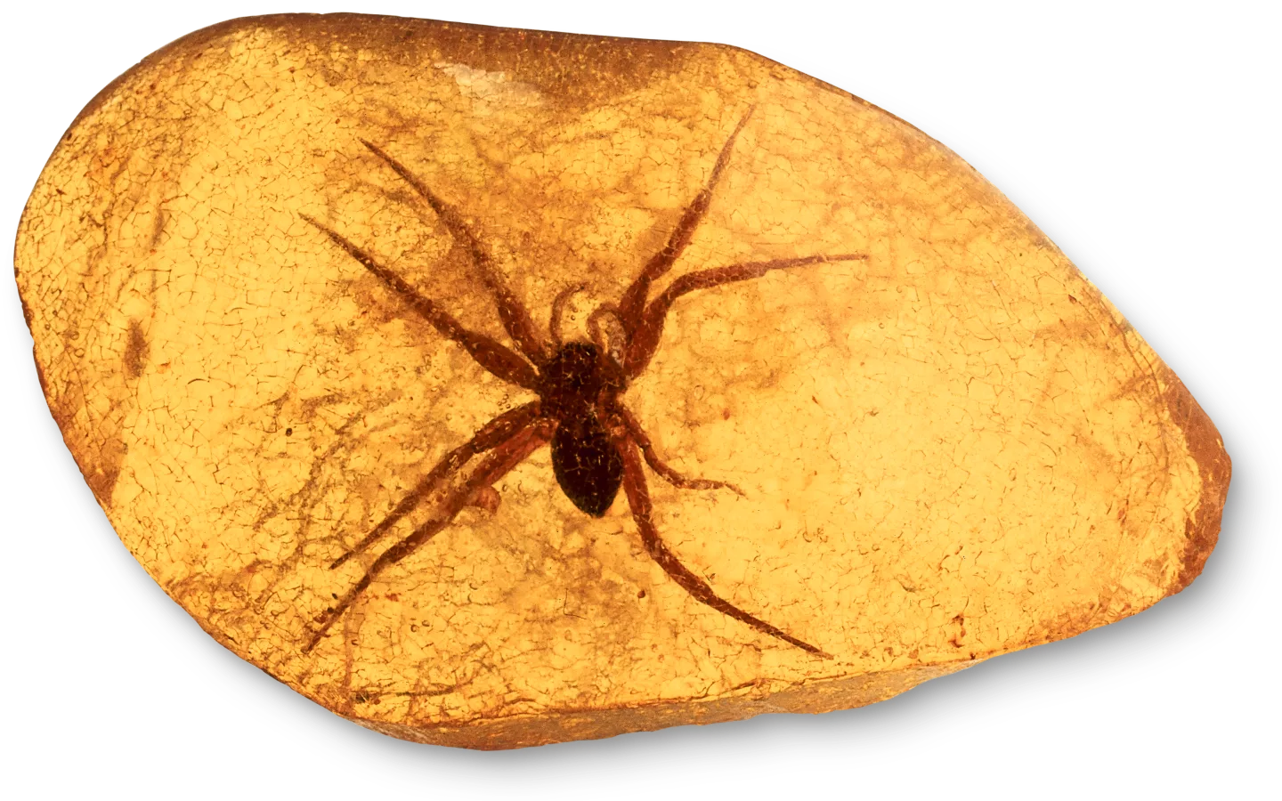
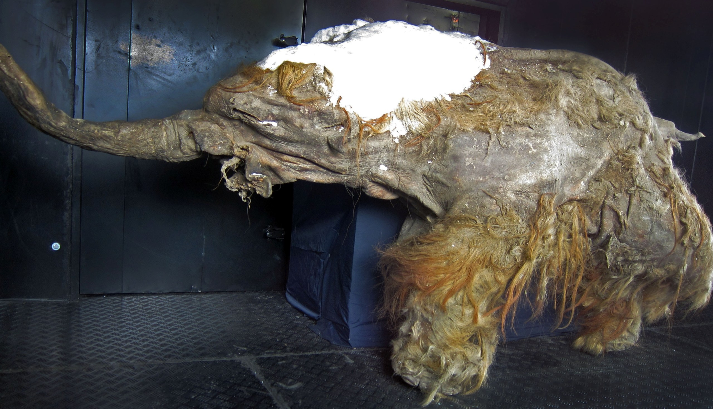
Preserved remains
The rarest form of fossilisation is the preservation of original skeletal material and even soft tissue.

Slide 9
Explain the origin of fossils and relate them to breaking God's Laws

Slide 10
Fossils were created when creatures and plants died. They sank into the ground and over time sediment built up over the top and hardened into rock. Fossils came about as a result of the flood. The flood was God's way of punishing the people who sinned and turned their backs to Him. Sin is breaking God's Laws and death is the judgement. Every fossil provides mute testimony to the fact that the “judgments of the Lord are true and righteous altogether” (Ps. 19:9).

Slide 11
Creation
Sin enters world
Sin = breaking God's Laws
More sin takes over world
God sends flood
Removes all evil
Buries death (fossils) in Earth's crust

Slide 12
Fossils Honour

Slide 13
Requirement 2
Have a brief definition of each of the following words.

Slide 14
a. Geology
  Geology is the science and study of the solid matter that constitutes the Earth.
b. Fossils
  Fossils are the preserved remains of animals, plants, and other organisms.
c. Catastrophism
  Catastrophism is the idea that Earth has been affected by sudden, short-lived, violent events.
d. Paleontology
  Paleontology is the study of prehistoric life forms on Earth through the examination of plant and animal fossils.
e. Graptolite
  A Graptolite is a fossil colonial animal known chiefly from the Upper Cambrian through the Lower Carboniferous (Mississippian) periods.

Slide 15
f. Trilobite
  Trilobites are extinct arthropods that form the class Trilobita. They appeared in the 2nd Epoch (Series 2) of the Cambrian period and flourished throughout the lower Paleozoic era before beginning a drawn-out decline to extinction when, during the Late Devonian extinction, all trilobite orders, with the sole exception of Proetida, died out.
g. Dinosaur
  A dinosaur is any of various extinct reptiles.
h. Mammoth
  A mammoth is any species of an extinct genus of proboscidean (elephants and their extinct relatives), often with long curved tusks and, in northern species, a covering of long hair.
i. Mastodon
  Mastodons are members of the extinct genus Mammut of the order Proboscidea and form the family Mammutidae; they resembled, but were distinct from, the woolly mammoth which belongs to the family Elephantidae. Mastodons were browsers and mammoths were grazers.

Slide 16
j. Crinoid
  Crinoids, also known as "sea lilies" or "feather-stars", are marine animals that make up the class Crinoidea of the echinoderms (phylum Echinodermata). There are only a few hundred known modern forms, but crinoids were much more numerous both in species and numbers in the past. Some thick limestone beds dating to the mid- to late-Paleozoic are entirely made up of disarticulated crinoid fragments.
k. Lingula
  Lingula is a genus of brachiopods.
l. Calamite
  A fossil made when sediment filled the hollow stem of a plant.
m. Foraminifera
  The Foraminifera are a large group of unicellular organisms with reticulating pseudopods, fine strands of cytoplasm that branch and merge to form a dynamic net. They typically produce a test, or shell, which can have either one or multiple chambers, some becoming quite elaborate in structure. About 275,000 species are recognized, both living and fossil.

Slide 17
n. Radiolaria
  Radiolaria are amoeboid protozoa that produce intricate mineral skeletons, typically with a central capsule dividing the cell into inner and outer portions, called endoplasm and ectoplasm. They are found as zooplankton throughout the ocean, and because of their rapid turn-over of species, their tests are important diagnostic fossils found from the Cambrian onwards.
o. Paleozoic
  The Paleozoic Era is the earliest of three geologic eras of the Phanerozoic eon. The Paleozoic era is defined by evolutionary geologists as spanning from roughly 542 million years ago to roughly 251 million years ago.
p. Mesozoic
  Lying between the Paleozoic and the Cenozoic, Mesozoic means 'middle animals'. It is often called the 'Age of the Dinosaurs'.
q. Cenozoic
  The Cenozoic Era is the latest of three geologic eras of the Phanerozoic eon. Evolutionary geologists define this era as having started about 65 million years ago, when the age of the dinosaurs ended.

Slide 18
r. Pleistocene
  The Pleistocene epoch on the evolutionary geologic timescale is the period from 1,808,000 to 11,550 years before present. The Pleistocene epoch had been intended to cover the world's recent period of repeated glaciations, or the Ice Age.
s. Paleobotany
  Paleobotany is the branch of paleontology or paleobiology dealing with the recovery and identification of plant remains from geological contexts, and their use for the biological reconstruction of past environments. Paleobotany includes the study of terrestrial plant fossils, as well as the study of prehistoric marine photoautotrophs, such as photosynthetic algae, seaweeds or kelp.
t. Pelecypod
  Pelecypod are molluscs belonging to the class Bivalvia. They typically have two-part shells, with both valves being symmetrical along the hinge line. The class has 30,000 species, including scallops, clams, oysters and mussels.
u. Brachiopod
  Brachiopods are two-shelled marine animals with an external morphology superficially resembling pelecypods (for instance, clams) of phylum Mollusca to which they are not closely related. It is estimated by paleobiologists that 99 percent of all documented lamp-shell species are both fossils and extinct.

Slide 19
Requirement 4
Describe the process of the proper removal of delicate specimens. Tell how a skeleton of a dinosaur or other gigantic fossil would be removed. Why should beginners not remove such specimens? What should be done by the beginner when they find what is obviously a valuable fossil?

Slide 20
Removal of delicate specimens
For extracting fossils from harder rocks, a sturdy mallet and cold steel chisels may be required. Before attempting to extract the specimen, one should make sure it is feasible to remove wihtout destroying or damaging it.

Slide 21
Removing gigantic fossils
A gigantic fossil would need to be supported using a jacket of plaster which protects it from shattering.

Slide 22
Valuable fossils
Beginners should not remove such specimens because it is easy to ruin and damage them.
The beginner should contact a professional. If it is on public land, contact the authority responsible for the land since they choose what is done with the fossil.

Slide 23
Requirement 5
Explain the difference in the account scientists give for the presence of fossils as related by evolutionists and creationists.

Slide 24
Evolutionists and creationists both agree that fossils are formed when a creature is quickly buried in sediment. They disagree on how long ago this happened.
Evolutionists believe most fossils were made millions of years ago.
Creationists believe that nearly all fossils were made during Noah's flood less than 10,000 years ago.

Slide 25
Requirement 6
From the Bible and writings of Ellen G. White cite statements to explain the origin of the following:
a. Coal
b. Petroleum
c. Fossils
d. Limestone

Slide 26
From Patriarchs and Prophets, pp 107, 108
Everywhere were strewn the dead bodies of men and beasts. The Lord would not permit these to remain to decompose and pollute the air, therefore He made of the earth a vast burial ground. A violent wind which was caused to blow for the purpose of drying up the waters, moved them with great force, in some instances even carrying away the tops of the mountains and heaping up trees, rocks, and earth above the bodies of the dead.At this time immense forests were buried. These have since been changed to coal, forming the extensive coal beds that now exist, and also yielding large quantities of oil. The coal and oil frequently ignite and burn beneath the surface of the earth. Thus rocks are heated, limestone is burned, and iron ore melted.

Slide 27
Coal – from the bodies of the dead during the flood
Petroleum – from oils of plants and animals in brackish water
Fossils – made by the dead, buried
Limestone – burned beneath the surface of the Earth

Slide 28
Homework.
Requirement 1
Requirement 3

Slide 29
Requirement 1
Make a collection of at least ten different kinds of fossils and label each with its name and geographic location.

Slide 30
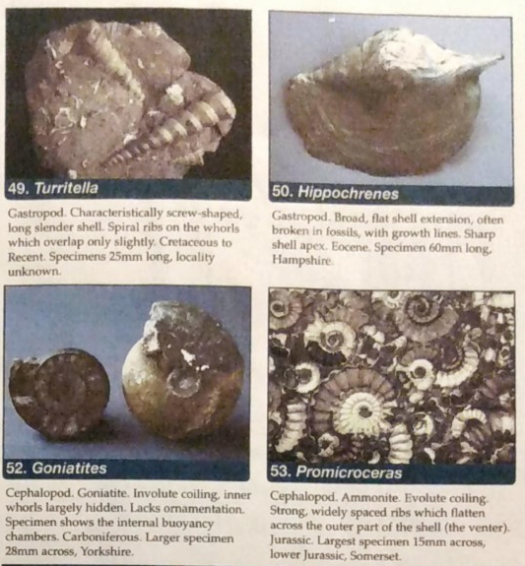
Picture of fossil
Name of fossil
Where fossil was found

Slide 31
Requirement 3
Visit a museum where fossils are on display and make a written or oral report of your trip.

Slide 32
Visit the website
https://www.nhm.ac.uk/discover/fossils.html

