Slide 1
Fern honor
VOYAGERS class

Slide 2
1. HOW ARE FERNS DIFFERENT FROM FLOWERING PLANTS OR TREES
Flowering plants ( including trees) produce seeds, while ferns produce spores.
A key difference between spores and seeds is that spores have very little stored food resources compared with seeds and therefore they require more favorable conditions in order to successfully germinate

Slide 3
2. Where is the true stem of a fern? What part grows above the ground?
The true stem of a fern grows underground
All of the above ground parts of a fern are known collectively as the frond

Slide 4
What is the favorable environment in which ferns grow
Ferns usually grow in moist, shady woodland nooks

Slide 5
3. HOW DO FERNS REPRODUCE
A mature fern, called a sporophyte fern produces spores through a process called meiosis. Each spore has only half the genetic material of the parent plant, a condition called haploid.
The spores are dispersed
A spore grows by cell division into a gametophyte - still with only half the genetic material of an adult organism.
The gametophyte produces both sperm and eggs on the same organism using a process called mitosis
The sperm swims to an egg and the plant is then fertilizes.

Slide 6
LOCATE AND DESCRIBE THREE DIFFERENT TYPES OF SORI
Woodwardia
This genus of ferns is commonly known as the "chain fern" because the sori are arranged in broken lines, somewhat resembling a chain.
Pteridium
This genus of ferns is commonly known as "bracken". The sori are arranged along the edge of the frond, and the edge is curled over slightly.
Andiantum
This genus has kidney-shaped sori along the edge of the fronds.

Slide 7
4. How do spores travel from the parent plant to a new location? How long does it take a spore to develop into a mature plant?
Spores are stored by the fern in tiny cases called sporangia.
These cases split open and the spores and carried by the wind to a new location
If the spore lands in a location with favourable conditions, it will develop into a gametophyte in about two weeks. If the gametophyte is fertilized, it will grow into a young fern in about 3 and a half months. The amount of time required for these growth periods varies greatly depending on conditions and the species.

Slide 8
Observe from live ferns or pictures how a young fern is different from an adult fern.
Young polystichum
Mature polystichum

Slide 9
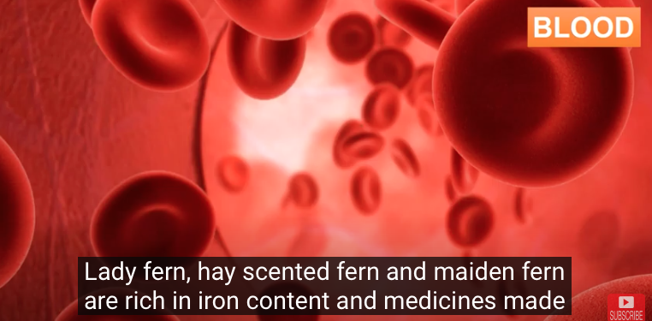
5. Know the medical uses of three ferns

Slide 10
MAIDENHAIR FERN
6. DRAW OR PHOTOGRAPH TEN KINDS OF FERNS AND PROPERLY IDENTIFY THEM
These ferns are the member of Adiantum family. Maidenhair usually grow ashore and it has a delicate fronds and branched like a waxy hand. Maidenhair is a common plant discovered in a moist environments such as lagoon, pond, stream, and waterfall. Maidenhair requires a high humidity of planting media, therefore you need to prepared all of those things if you want to grow this type of fern. Maidenhair is fragile with the direct sunlight, so indirect sunlight is the best option for keeping this plant.

Slide 11
BOSTON FERN
This type of fern usually grown in a hanging basket in front of your porch. The ideal temperature for this fern is between 60 to 75 degree of fahrenheit. Boston fern or Nephrolepis exaltata can be recognized with their dark green leaves and arching feathers. Boston fern can’t stand in a lower temperature, so keep them in the previous temperature as it already mentioned before. Misting this plant for a dense collection of plants are also a good idea.

Slide 12
HOLLY FERN
This fern is originated from the Eastern Continent. The reason why I put this fern into Indoor category because Holly ferns blooms in a low sunlight. Therefore it would be a good idea to grow this fern inside your house. The advantage for growing this plant are it’s deer and drought resistant. The most popular types of this fern are Polystichum lonchitis and Cyrtomium falcatum.

Slide 13
Bird’s Nest Fern
This fern consist of an Asplenium range of brushes dispersed in the genus of Asplenum serratum, Asplenium nidus, Asplenium australiasicum and Asplenium antiquum. The bird’s nest is an organic fern and it’s need lot of air nutrients and rain dampness. Make sure give this fern sufficient moisture and keep the away from direct sunlight if you want to add this fern as your additional plant collection.

Slide 14
Cinnamon Ferns
The Cinnamon fern are rich in sterilized cinnamon-colored fronds and it has green leafy leaves. They need a moist and cool breeze of air to fully grown stage. They didn’t requires a complicated treatment. You just need a trimming, wet dirt and fertilizers. And there you are, a beautiful Cinnamon fern will mesmerizing your outdoor garden.

Slide 15
Asparagus Ferns
sparagus ferns are tough and you might want to give attention for this fern because it can also engulfed your whole garden with their branches. The botanical name for this fern are vary, start with Asparagus setaceus, Asparagus aethiopicus, Asparagus plumosus, Asparagus densiflorus and Asparagus virgatus. Don’t be deceived for its good names. this fern are not related with Asparagus. Asparagus fern is an ornamental plants equipped with cladodes stems.

Slide 16
Australian Tree Fern
The Australian Tree Fern is a unique fern because it’s similiar with a tree from their physical appearance. They need an adequate water and sufficient humidity. You shouldn’t sprinkled over the soil around the follicles. Otherwise, it will die for sure. This fern can grow around 4 metres in width. To grow this fern, you need to give it an indirect sunshine. And don’t forget to give a sufficient fertilizer and insectiside if necessary.

Slide 17
Japanese Painted Fern
Japanese Painted Fern has a scientific names called Athyrium niponicum. It has a unique blending of silver and green color. This fern loses it’s feathers when the winter comes. Japanese Painted Fern can grown into 7 to 11 inches. If you want to grow this plant, make sure that you have enough damp soil and humidity. Or, you can plant this fern on indirect sunlight situation. Don’t put this ferns in a hot situation of summer otherwise it can burns fronds.

Slide 18
Cloverleaf
The next kind of fern is cloverleaf. This fern species can be located everywhere. You can found cloverleaf in your garden, lawn or they might be hiding under the rock. This fern species is considered as a plant with the complete body structure consisting of roots, stem and leaves. The example of this fern is the Cloverleaf. Cloverleaf usually has 4 leaves on each plant. 5 leaves cloverleaf is very rare to be found. That is why, you must be very lucky if you accidentally found Cloverleaf with 5 leaves.

Slide 19
Whisk Fern
Whisk fern (Psilotum nudum) is a fernlike plant that has unique thin stems, which resemble chicken’s feet. The plant grows in tropical Africa, South America, North America, Australia, tropical Asia, New Zealand, Hawaii, Japan, and Spain. Whisk fern is unique because it does not have typical vascular plant organs. This plant is a popular garden plant in Japan, and people grow them between decorative rocks. Hawaiian people in the past used this plant’s spores to prevent skin chafing under loincloths.

Slide 20
7. In addition to the common ferns there are fernlike plants known as club mosses and horsetails. Be able to recognize two club mosses and one horsetail.
Equisetum arvense (Field Horsetail)
Lycopodium clavatum (Ground pine)
Lycopodium serratum (Toothed clubmoss)

Slide 21
How are they similar to ferns
Both produce spores instead of seeds
Both grow in moist shady locations
Can be seen cohabitating

